Slide 1
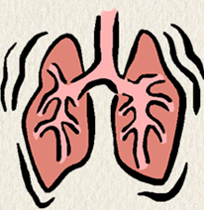
Bronchial Asthma in Children
Enas Al Zayadneh
Pediatric Pulmonologist ,JUH

Slide 2
Introduction
Bronchial asthma is the most common inflammatory condition in children and adults
with significant morbidity world wide.
In Jordan, MOH estimates 10% of population are diagnosed with bronchial Asthma .

Slide 3
Definition
Chronic condition characterized by :
Airway inflammation airway inflammation cause recurrent or persistent bronchospasm, which causes symptoms including wheezing, breathlessness, chest tightness, and cough, particularly at night or after exercise.
Infiltration of inflammatory cells, including mast cells, and eosinophilic and neutrophilic granulocytes .
.

Slide 4
Hyperresponsiveness (BHR),
Airway inflammation is associated with airway hyperreactivity or bronchial hyperresponsiveness (BHR), which is defined as the inherent tendency of the airways to narrow in response to a variety of stimuli (eg, environmental allergens and irritants).
Chronic inflammation, persistent changes , i.e. airway remodelling

Slide 5
Pathophysiology:
Inflammation :
Interactions between environmental and genetic factors 🡪
-(EARLY PHASE 15-30m) :, o functional and structural changes (IgE mediated from mast cells ) –> Bronchospasm :
-(LATE PHASE 4-12hr) : inflammation,cell infiltration ->mucosal edema, and mucus plugs
Hyperinflation :overdistention helps maintain airway patency, improving expiratory flow-🡪
Increases work of breathing

Slide 6
Hyperinflation ---> compensates for the airflow obstruction, but this later on causes alveolar hypoventilation V/Q mismatch -🡪 HYPOXIA
Hyperventilation triggered by the hypoxic drive also causes a decrease in PaCO2 hypercarbia is prevented by the ready diffusion of carbon dioxide across alveolar capillary membranes.Respiratory alkalosis
e in the early stages of an acute episode have hypoxemia in the absence of carbon dioxide retention..

Slide 7
With worsening obstruction and increasing ventilation-perfusion mismatch, carbon dioxide retention occurs.
Later, the increased work of breathing, increased oxygen consumption, and increased cardiac output result in metabolic acidosis. Respiratory failure leads to Respiratory Acidosis.
Chronic inflammation of the airways is associated with increased BHR,. In some patients with chronic asthma, airflow limitation may be only partially reversible because of airway remodeling (hypertrophy and hyperplasia of smooth muscle, subepithelial fibrosis) that occurs with chronic untreated disease.

Slide 8
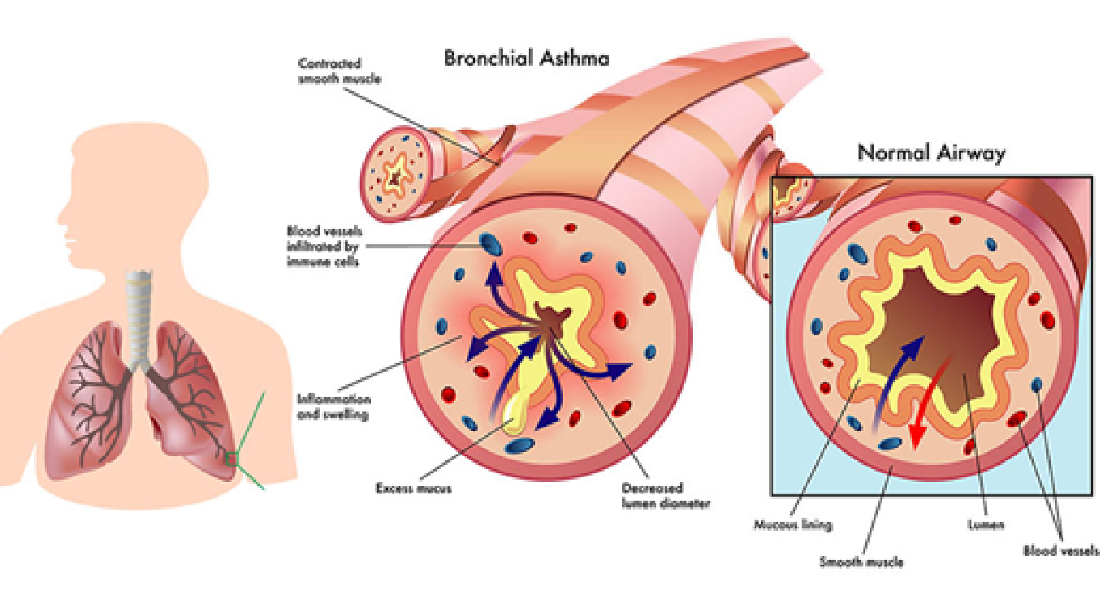

Slide 9
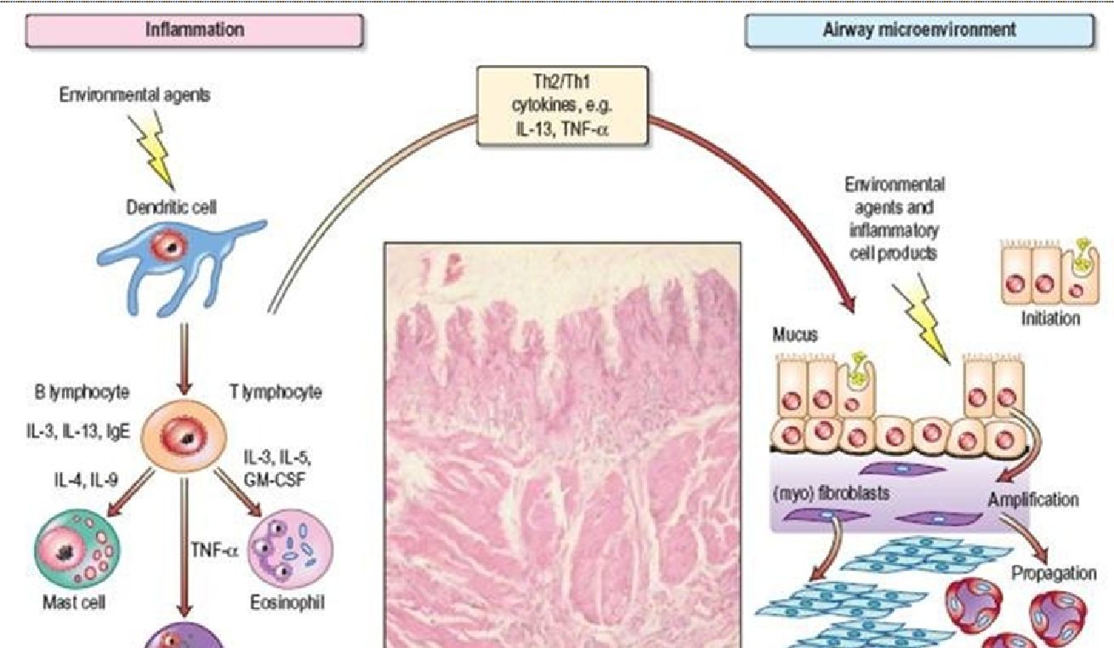
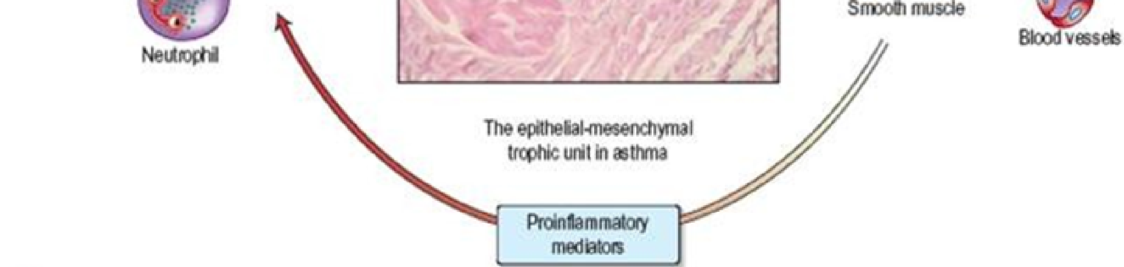

Slide 10
Update in airway inflammation in children
Aetiology of airway inflammation in asthmatic children varies depending on age :
Viral infections (RV and RSV) linked to obstructive bronchitis in infancy and early childhood and considered controversially a combined risk factor with allergen sensitization .

Slide 11
Viruses and Asthma !
Rhinovirus and respiratory syncytial virus damage the respiratory epithelium 🡪 less resistant to inhaled allergens 🡪 enhanced T-helper (Th)2 responses in predisposed children and the development of allergic inflammation .

Slide 12
Other RT infections :
fungi (ABPA,), bacteria(Mycoplasma,Pertussis), parasites.
Most children who have persistent wheeze and asthma have high IgE and Eosinophildic response (airways and circulation) at the time of the fisrt URTI.

Slide 13
Aerosensitizatio
Sensitisation and exposure to allergens is the major cause of allergic airway inflammation in older children.
Immunoglobulin (Ig)E-mediated allergy leading to allergic inflammation is common among children with persistent asthma.

Slide 14
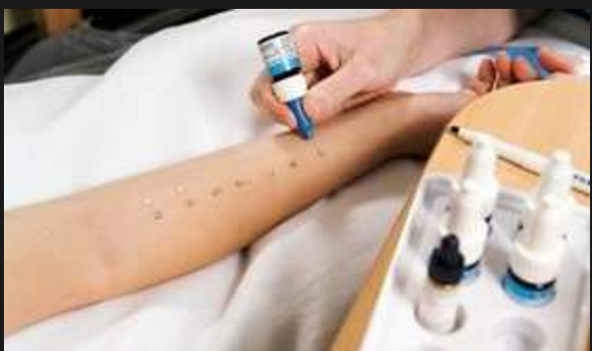
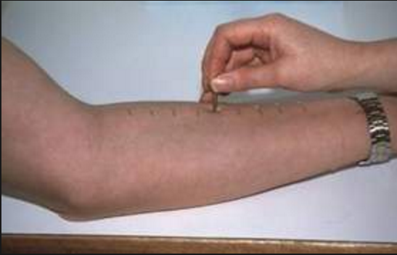
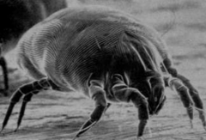

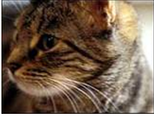
SPT

Slide 15
Aresosensitizatio + Viruses
Synergistic effect between viral infections and aeroallergen exposure, and subsequent sensitisation in genetically predisposed children .
Viral infections are the most important cause of asthma exacerbations in all age groups

Slide 16
Gene-by-environment interaction ; genetic background of the child, with a cytokine imbalance toward Th2, will promote the production of IgE antibody to environmental antigens (eg, dust mites, cockroaches, Alternaria, and possibly cats).

Slide 17
Genetics
2 new loci with asthma risk:
rs4129267 in IL6R and rs7130588 on band 11q13.5.
IL6R association 🡪 cytokine dysregulation affects asthma risk
11q13.5 locus 🡪 allergic sensitization and subsequent development of asthma.

Slide 18
Main types of childhood asthma;
1-recurrent wheezing/early childhood,triggered by common viral infx. Of respiratory tract.
2-chronic astma ass. With allergy persist into later childhood and often adulthood (most common)
-asthma in female,obese,early puberty
-Occupational exposure-mediated astma
Triad Astma ,onset rare in children .
Male:female 2:1 till puberty (equal ) then female pred. after puberty

Slide 19
Risk Factors:
(1) Parental history of asthma, a physician diagnosis of atopic dermatitis, or evidence of sensitization to aeroallergens
OR (2) two of the following:
evidence of sensitization to foods, ≥4 percent peripheral blood eosinophilia, or wheezing apart from colds .

Slide 20
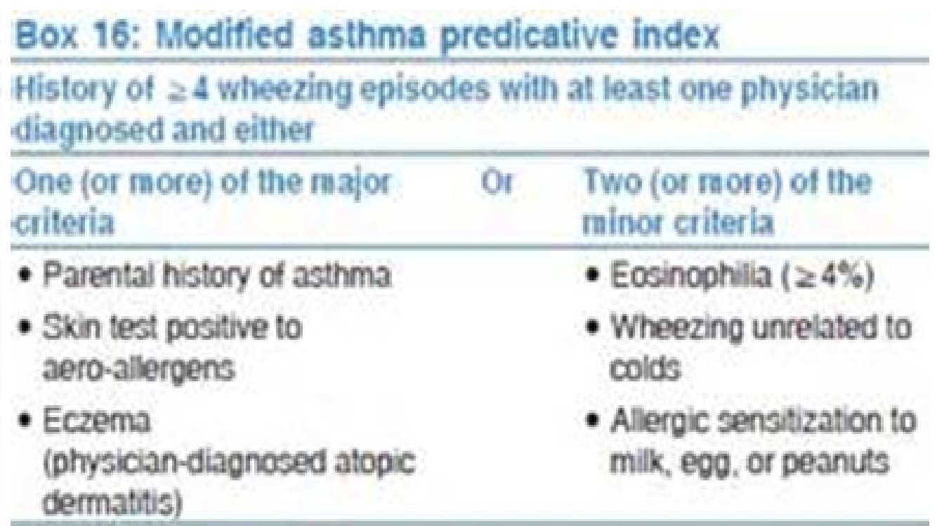
Asthma Predictor Index

Slide 21
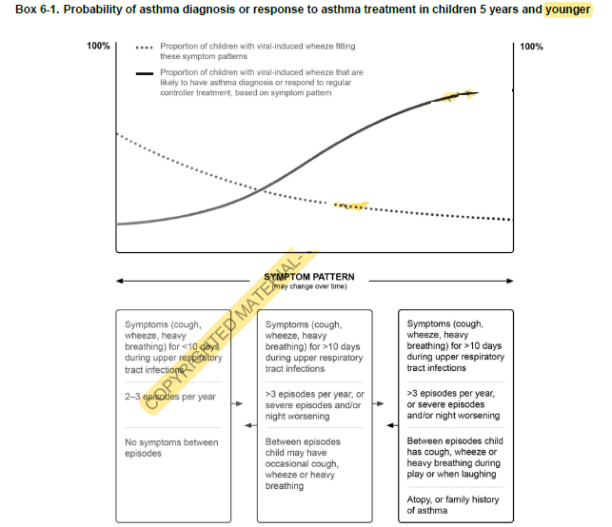

Slide 22
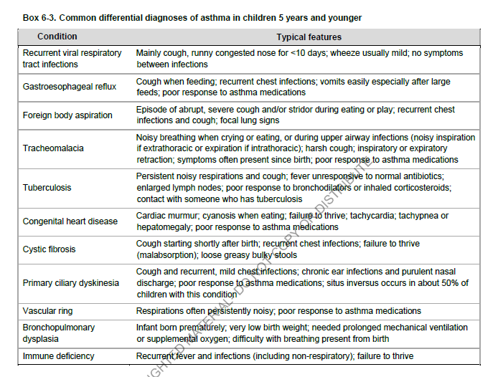

Slide 23
Epidemiology
In USA most common pediatric emergency department visits-admissions.
Increasing prevalence in childhood astma ,despite improvement in mx.
80% onset before 6 yr , but most children with recurrent wheesing in early childhood will not have persistant asthma in later childhoo.
Two thirds of all asthma cases are diagnosed <18 yr.
Approximately half of all children diagnosed with asthma have a decrease or disappearance of symptoms by early adulthood.

Slide 24
Asthma triggers
Aeroallergens in sensitized asthmatics:
Common viral infx of resp. tract
Animal dander
Indoor allergens (dust mites, cockroaches,molds)
Seasonal aeroallergens: pollens(trees,grasses,weeds)-seasonal molds
Environmental tobacco smoke
Air pollutants (ozone ,sulfer dioxide,particulate matter .wood-coal-burning smoke ,endotoxins ,mycotoxins ,dust)
Strong/noxious odors/fumes( perfumes ,hairsprays,cleaning agents )
Occupational exposure ( farm/barn exposure, formaldehydes,paint fumes,cedar)
Cold air , dry air
Exercise
Crying ,laughter ,hyperventillation )
Co-morbid conditions ( Rhinitis ,Sinusitis ,GERD )

Slide 25
Clinical manifestations
HISTORY :A detailed medical history should address (1) whether symptoms are attributable to asthma, (2) whether findings support the likelihood of asthma (eg, family history), (3) asthma severity, and (4) the identification of possible precipitating factors.
Symptoms may include the following:
Cough
Wheezing
Shortness of breath
Chest tightness
Sputum production
symptom patterns can vary as follows:
Perennial versus seasonal /Continual versus episodic/ Duration, severity, and frequency
Diurnal variations (nocturnal and early-morning awakenings)

Slide 26
Acute severe episode :
breathlessness at rest
Not interested in feeding
Sits upright
Talks in words not sentences
Usually agitated
Imminent respiratory arrest :drowsy,confused( not necessary in adolescents )

Slide 27
PHYSICAL EXAMINATION
General
Evidence of respiratory distress ;increased respiratory rate, increased heart rate, diaphoresis, and use of accessory muscles of respiration.
Marked weight loss or severe wasting may indicate severe emphysema.
Pulsus paradoxus: This is an exaggerated fall in systolic blood pressure during inspiration and may occur during an acute asthma exacerbation.
Depressed sensorium: This finding suggests a more severe asthma exacerbation with impending respiratory failure.

Slide 28
End-expiratory wheezing or a prolonged expiratory phase /most commonly, although inspiratory wheezing can be heard.
Diminished breath sounds and chest hyperinflation may be observed during acute exacerbations.
The presence of inspiratory wheezing or stridor may prompt an evaluation for an upper airway obstruction such as vocal cord dysfunction, vocal cord paralysis, thyroid enlargement, or a soft tissue mass (eg, malignant tumor).
        Upper airway exam. :
Erythematous or boggy turbinates or the presence of polyps from sinusitis, allergic rhinitis, or upper respiratory infection.
Any type of nasal obstruction may result in worsening of asthma or symptoms of EIA.

Slide 29
    Skin: Observe for the presence of atopic dermatitis, eczema, or other manifestations of allergic skin conditions.

Slide 30
P/E in severe episode:
RR > 30
Use of accessory muscles
Suprasternal retractions
HR > 120/minute
Loud biphasic (expiratory and inspiratory ) wheeze
Pulsus paradoxus present( 20-40 mmHg)
Po2 sat RA <91%

Slide 31
P/E in status asthmaticus with pending respiratory arrest :
Paradoxical thoracoabdominal movements
Wheeze may be absent
Severe hypoxemia may manifist as bradycardia
Pulsus paradoxus may disappear

Slide 32
Laboratory Findings
Lung Function Tests
SPIROMETRY; measures lung volumes and airflow during forced expiration(gold standard in asthma) :
Airflow limitation (low FEV 1 ,FEV 1/FVC < 0.8
Bronchodilator response : improvement in FEV1> = 12%
Exercise challenge : worsening in FEV1 >=15%
Peak flow morning-to-afternoon variation>=20% (PEF):monitor severity -zones

Slide 33
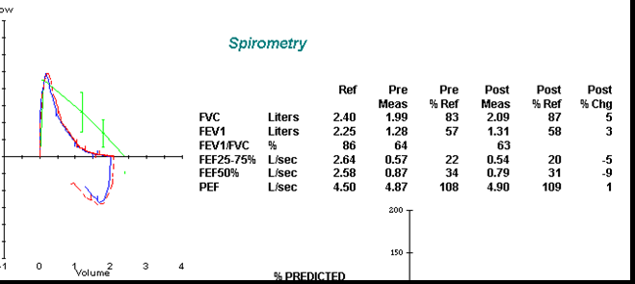

Slide 34
Exercise challenge test
Histologic evaluation
Challenge test :methacoline challenge test PC 20 < 4 mg/ml is positive .

Slide 35

Radiology
CXR (AP and LATERAL)
Often normal
Subtle nonspecific findings of hyperinflation and peribronchial thickening.
Helpful to exclude major DDx( aspiration pneumonitis ,bronchiolitis obliterans)
Complications of asthma (atelectasis,pneumothorax)
CT ,high resolution ,thin cuts (bronchiectasis in CF,ABPA,ID..etc)

Slide 36
Allergy testing to assess sensitization(inhalant allergen sens. By prick skin testing)
Fraction of Exhaled Nitric Oxide Testing

Slide 37
Diagnostic Challenge
DDx :
Airway Foreign Body
Allergic Rhinitis
Aspergillosis
Aspiration Syndromes
Bronchiectasis
Bronchiolitis
Bronchopulmonary Dysplasia
Cystic Fibrosis
Gastroesophageal Reflux
Primary Ciliary Dyskinesia

Slide 38
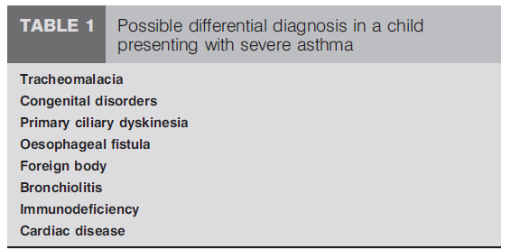

Slide 39
Considerations for Treatment
Control asthma by reducing impairment through prevention of chronic and troublesome symptoms (eg, coughing or breathlessness in the daytime, in the night, or after exertion)
Reduce the need for a short-acting beta2-agonist (SABA) for quick relief of symptoms (not including prevention of exercise-induced bronchospasm)
Maintain near-normal pulmonary function
Maintain normal activity levels (including exercise and other physical activity and attendance at work or school)
Satisfy patients' and families' expectations for asthma care

Slide 40
Components of Asthma Care
Assessment and monitoring
Education
Control of environmental factors and comorbid conditions
Pharmacologic treatment

Slide 41
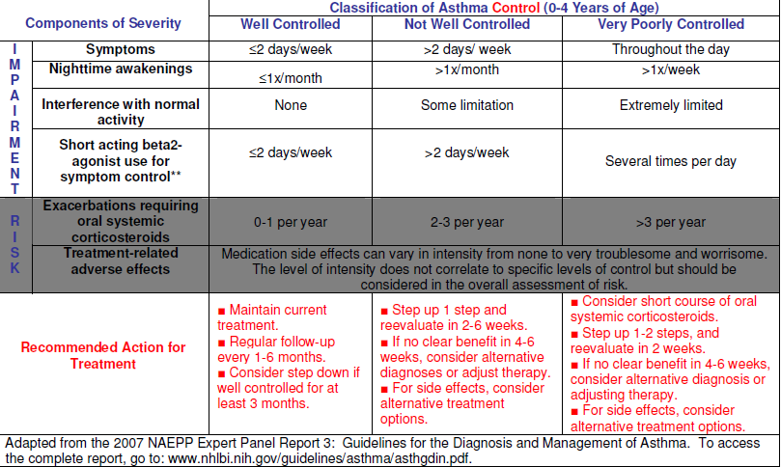
Assessment and monitoring

Slide 42
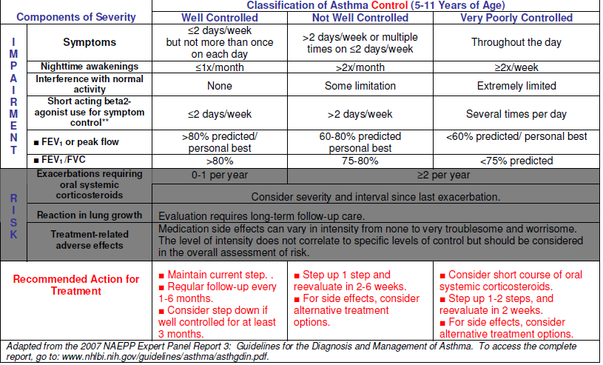
Assessment and monitoring

Slide 43
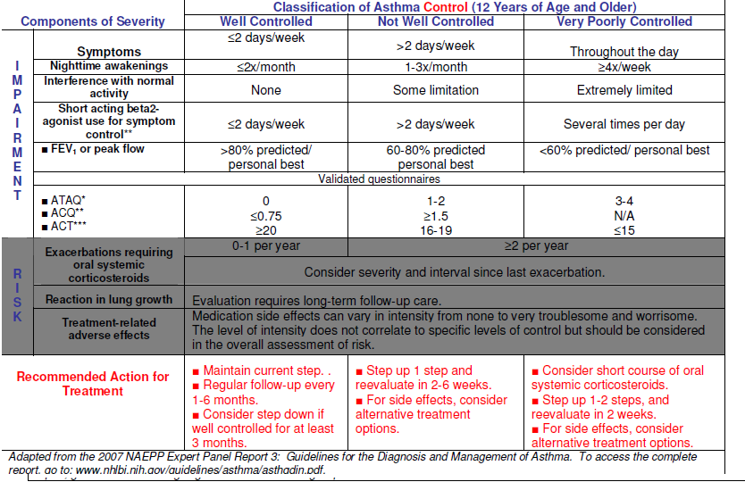
Assessment and monitoring

Slide 44
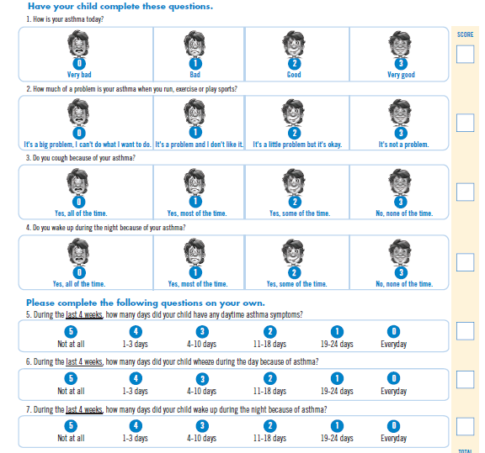
ACT test

Slide 45
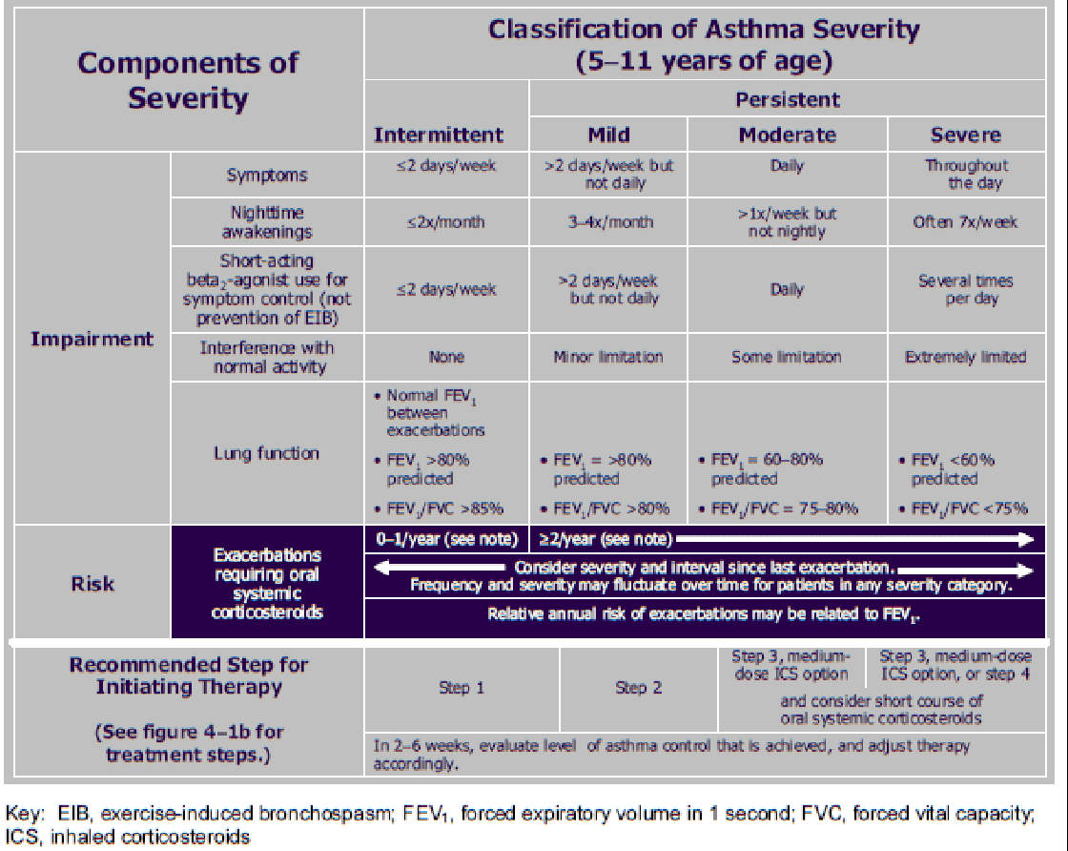

Slide 46
Assessment/Biomarkers for Asthma
Pulmonary function and BHR
Eosinophil in sputum and blood
Exhaled NO (FeNO)
urinary leukotrienes
Total and specific IGE

Slide 47
Consultations
Refer High risk patients to specialist :
History of sudden severe exacerbations
History of prior intubation for asthma
Admission to an ICU because of asthma
Two or more hospitalizations for asthma in the past year
Three or more emergency department visits for asthma in the past year
Use of 2 or more canisters of inhaled short-acting beta2-agonists per month
Current use of systemic corticosteroids or recent withdrawal from systemic corticosteroids

Slide 48
Consultations
Pulmonolosit ,Allergist
ENT specialist ,chronic rhinosinusitis
Gastroenterologist ,to exclude and/or treating gastroesophageal reflux.

Slide 49
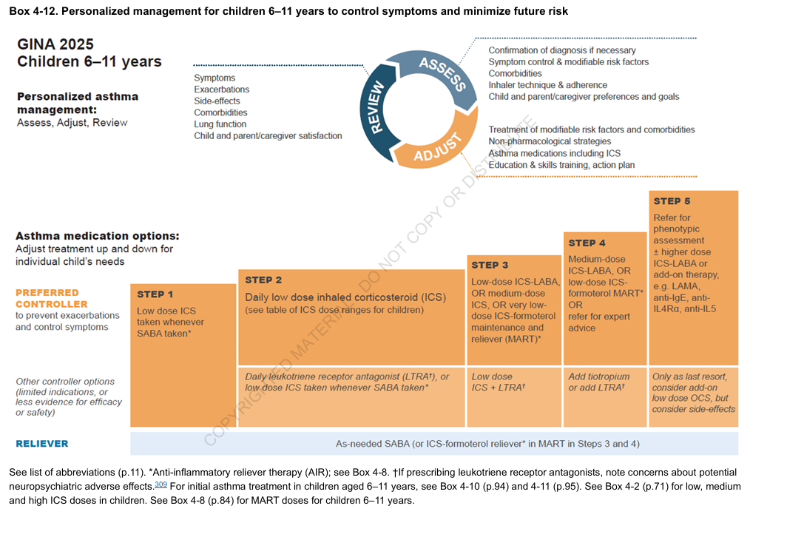
GINA 2025 6- 11 years
Notes:
GINA : Global Initiative for Asthma

Slide 50
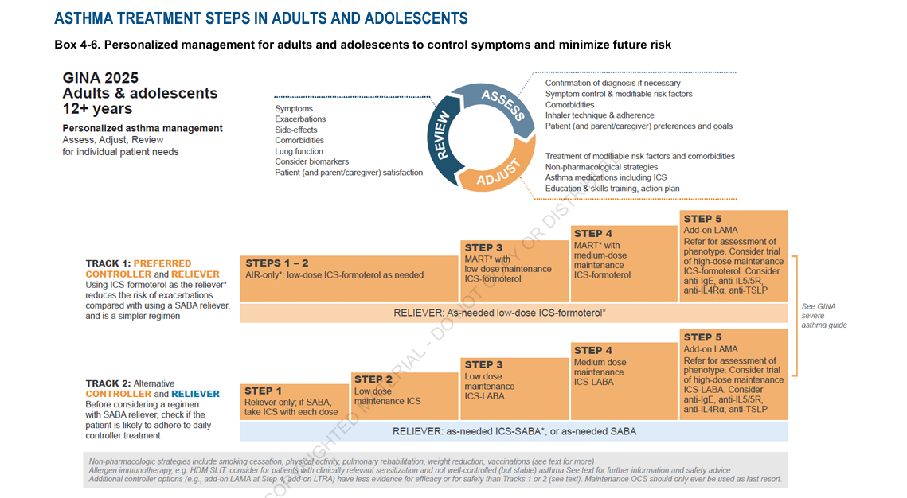
GINA 2025 adults and adolescents

Slide 51
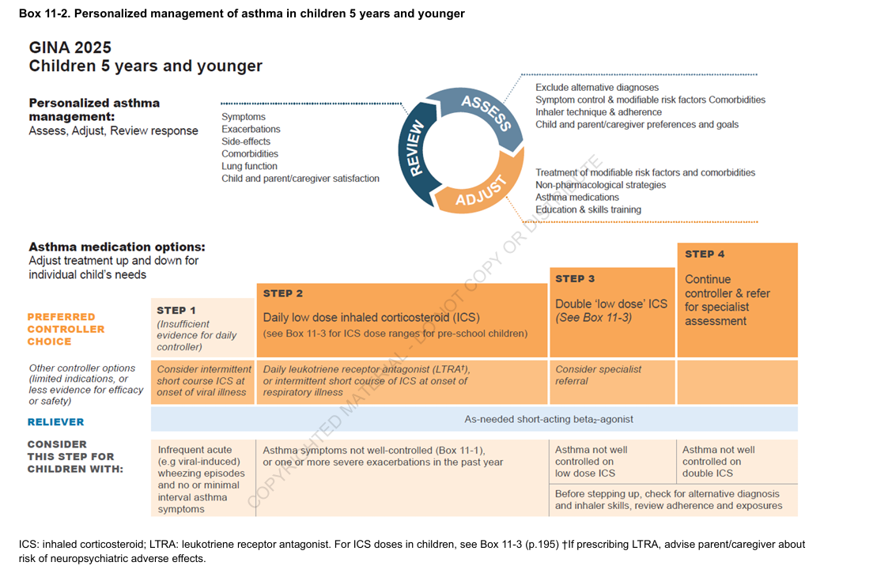

GINA 2025 less than 5 years

Slide 52
Delivery devices and best route of administration
Pressurized metered dose inhaler (pMDI) - Propellant used to dispense steroid when canister is pressed manually
•Dry powder inhaler (DPI) - Does not require hand-breath coordination to operate
•Breath-actuated pMDI - Propellant used to dispense steroid when patient inhales
•Nebulized solution devices

Slide 53
Technique /preferred devices
1-Children < 4 years : pMDI with a valved holding chamber + age-appropriate mask.
2-Children 4-6 years : a pMDI plus a valved holding chamber.
3-Children > 6 years : a pMDI, a DPI, or a breath-actuated pMDI.
4-For all 3 groups, a nebulizer with a valved holding chamber ,is recommended as alternate therapy

Slide 54
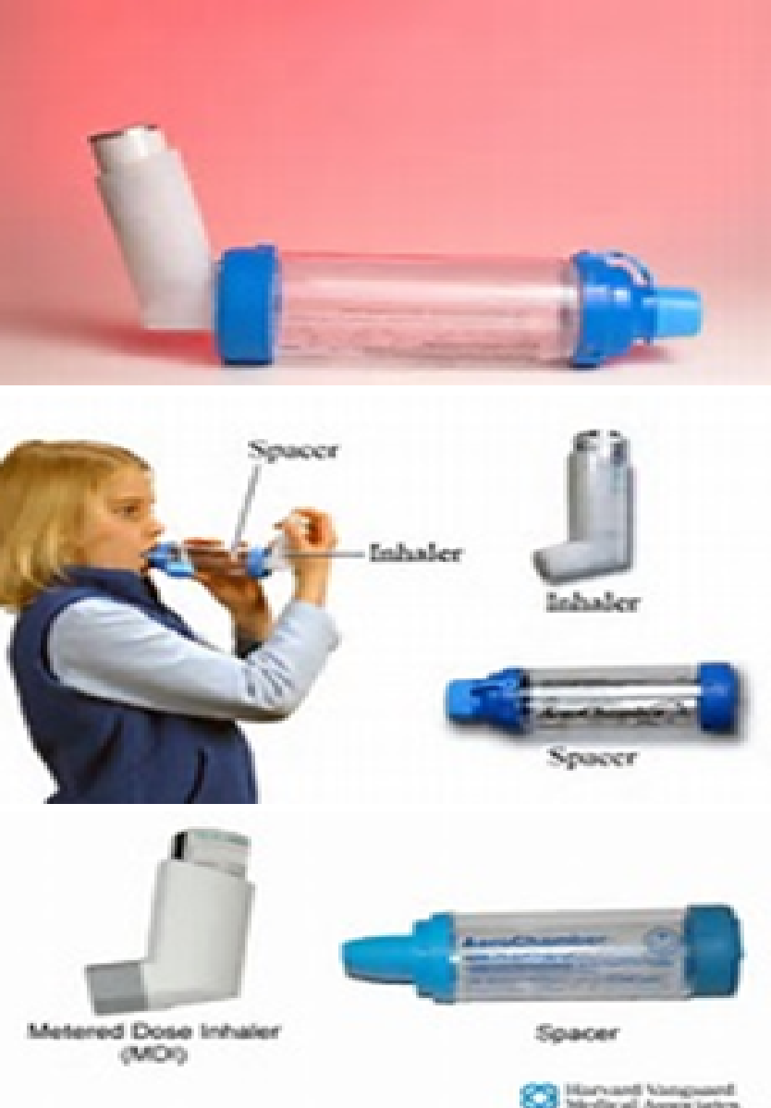
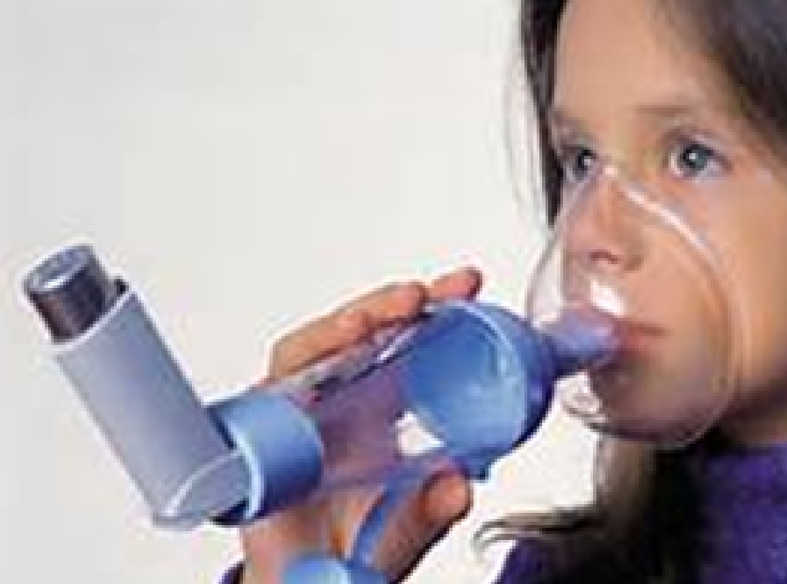
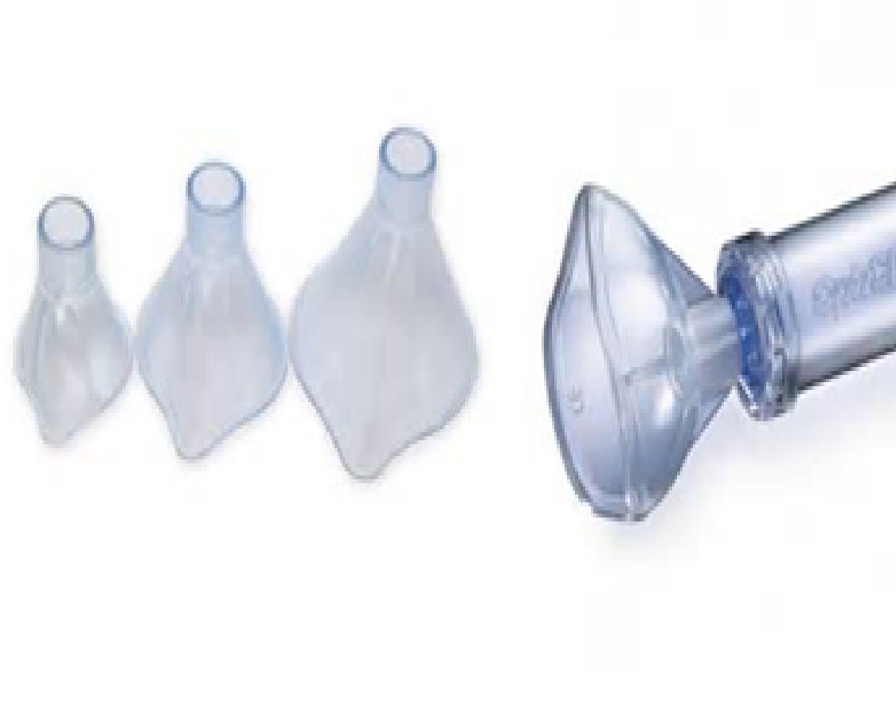
Technique :
MDI + Spacer

Slide 55
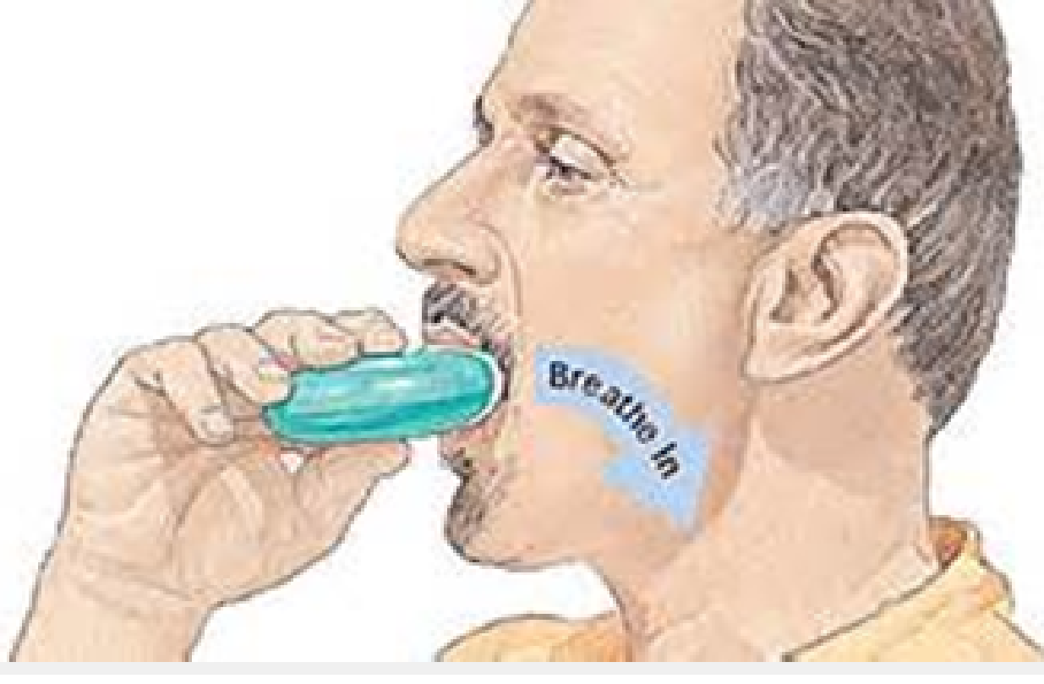
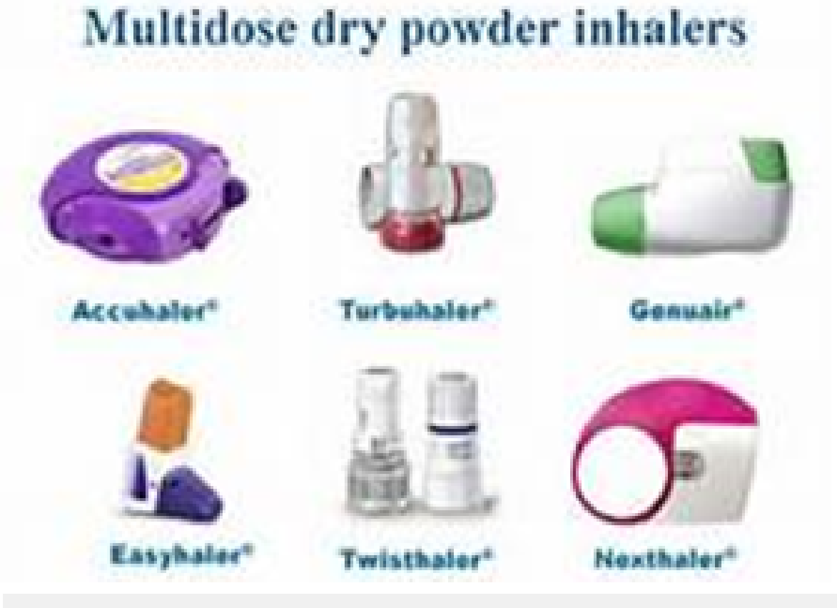
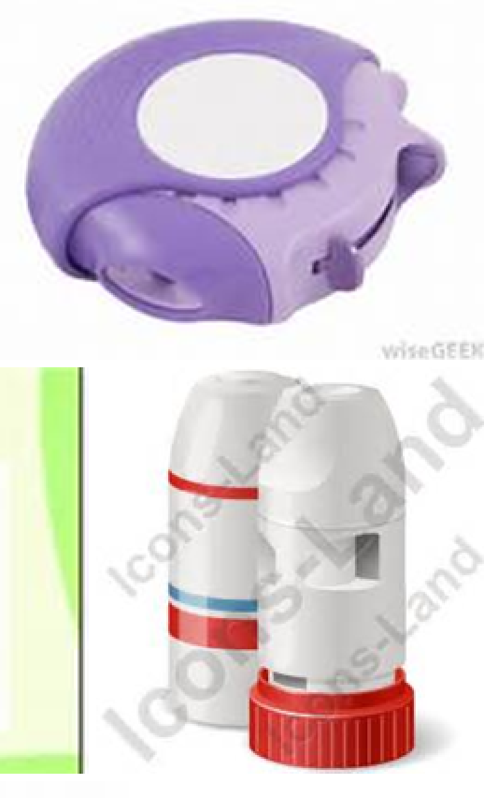
DPI

Slide 56
Quick-relief medications
Rapid-acting beta2-agonists as needed for symptoms
Short course of systemic steroids
Ipratropium Bromide

Slide 57
SABA
Used to treat bronchospasm in acute episodes
Prevent bronchospasm associated with EIA and nocturnal asthma.
Albuterol (MDI,solution for neb,oral)
Pirbuterol,levalbuterol,terbutaline
Prolonged use may produce tachyphylaxis (downregulation and receptor hyposensitivity)

Slide 58
SABA receptors
SABA may produce adverse effects (decreased PF and increased risk of exacerbations in pts homozygous for (Arg/Arg) att 16th aaposition of b-adrenergic receptor gene vs ( Gly-Gly).

Slide 59
Control /Long term medications
ICS: fluticasone,budesonide, beclomethasone
LABA: salmetrol ,formoterol
LTRA : montelukast
Combination LABA/ICS
Cromolyn/Nedocromil
Methylxanthines: Theophylline
Systemic steroids :dexamethasone,hydrocortisone,methylpredinisolone, prednisolone
LAMA (Long acting muscarinic antagonists ): Tiotropium bromide
Biological therapy

Slide 60
ICS
Topically active, poorly absorbed, and least likely to cause adverse effects.
Inhaled forms reduce the need for systemic corticosteroids.
-Block late asthmatic response to allergens
-Reduce airway hyperresponsiveness
-Inhibit cytokine production, adhesion protein activation, and inflammatory cell migration and activation
-Reverse beta2-receptor downregulation

Slide 61
ICS
Ciclesonode(Alvesco)
Fluticasone
Beclomethasone
Budesonide
Mometasone furate

Slide 62
LABA
Not for acute episodes
Preventive treatment of nocturnal and EIA
Should not be used as single agent (combination) if it other plans not successful.
Studies : may increase risk of severe asthma episodes and death with severe episodes.
Salmetrol,formoterol

Slide 63
Systemic steroids
Relief : (3-10 d) to gain prompt control of inadequately controlled acute asthmatic episodes.
Long-term :sevre persistent asthma .
Reverse beta2-receptor subsensitivity and downregulation
Higher-dose GCS no advantage in severe asthma exacerbations.
IV route no advantage over oral therapy

Slide 64
Leukotrienes Modifiers
Counteract leukotrienes action( bronchospasm, increased vascular permeability, mucosal edema)
- 5-lipoxygenase inhibitors: Zileuton
-Leukotriene-receptor antagonists :
Zafrilukast ,Montelukast

Slide 65
Co-morbidities
Bronchopulmonary aspergillosis
Gastroesophageal reflux disease (GERD)
Obesity
Obstructive sleep apnea
Rhinitis
Sinusitis
Depression
Stress
Low vitamin D levels

Slide 66
Biological treatment
Mepolizumab and benralizumab ( inhibit IL-5 binding to eosinophils )
Omalizumab : (IgE antagonist )
Reslizumab (IL5 antagonist ,adults )
Pitrakinra (IL4-/IL-13 antagonist)
Lebrikizumab (IL-13 antagonist)

Slide 67
Conclusion
A number of recent advances in treating asthma exist, HOWEVER
Importance of adhering to essentials in Treating childhood asthma.
Childhood asthma can be treated at community level.
Healthworkers should try to focus on improving quality of indoor and outdoor aie quality.

Slide 68
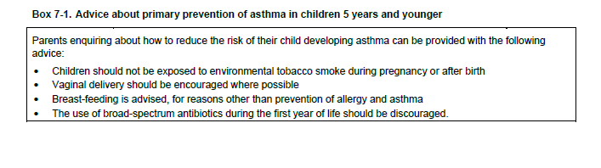

Slide 69
Management: Acute severe Asthma

Slide 70
Severe asthma is indicated by:
Apprehensiveness
Unable to complete sentences in one breath
SaO2<92% in room air after three appropriate doses of inhaled salbutamol within 60 mins.
Tachycardia >120 in children aged >5 yr >130 in children aged 2-5

Slide 71
Increasing tachycardia denotes worsening asthma or increasing doses of salbutamol. Tachycardia is universal in the setting of a salbutamol infusion. (? SVT)
Tachypnoea >30 in children aged >5 yr >50 in children aged 2-5 yr
Palpable pulsus paradoxus (equates to ≥15 mm Hg) – NB all asthmatics have some degree of pulsus paradoxus at rest.

Slide 72
Progressive worsening:
Agitation and Confusion
Exhaustion
Cyanosis
Increasing tachycardia. NB Decreasing heart rate is pre-terminal
Poor respiratory effort

Slide 73
Important Notes
1.Wheezing may be less apparent with increasing airway obstruction, with a silent chest occurring in life threatening asthma.
2. Clinical signs correlate poorly with severity of airway obstruction. Thus objective measurements with SaO2 are essential.

Slide 74
Important Notes
3. CXR may be abnormal but does not usually guide management. A pneumothorax may be revealed in severe respiratory failure.
4. Blood gases rarely guide therapy. A rising pCO2 may be indicative of worsening respiratory failure, but the decision to intubate is still a clinical one. Metabolic acidosis may be caused by salbutamol, particularly intravenous

Slide 75
Status asthmaticus
an acute exacerbation of asthma that remains unresponsive to initial treatment with bronchodilators.
varies from a mild form to a severe form with bronchospasm, airway inflammation, and mucus plugging that can cause difficulty breathing, carbon dioxide retention, hypoxemia, and respiratory failure.

Slide 76
Indications for consideration of admission to PICU
Severe acute asthma which has not responded adequately to continuous inhaled bronchodilators for one hour . and a single bolus of IV salbutamol (epinephrine ) and IV bolus of steroids

Slide 77
Aims of therapy in severe episode
Maintenance of adequate oxygenation (SaO2 ≥ 93%).
Maintenance of haemodynamic stability
Rapid bronchodilation

Slide 78
Maintenance of adequate oxygenation
Oxygen delivery is best by high flow oxygen via reservoir fitted facial mask (thereby increasing FiO2), with the aim of maintaining SaO2 ≥ 92%.
.

Slide 79
Why is there hypoxaemia?
Bronchial obstruction leading to ventilation-perfusion mismatch
+ hypoventilation
+ alveolar hypercarbia
+ acidotic pulmonary vasoconstriction.

Slide 80
What is hypoxaemia?
SaO2 <93% (PaO2 <80 mmHg).

Slide 81
Bronchodilators may paradoxically worsen the ventilation-perfusion mismatch, via preferential distribution of pulmonary blood flow to atelectatic areas.

Slide 82
Maintenance of haemodynamic stability

Slide 83
Haemodynamic compromise could result from :
Hypoxia – directly myocardial depressant
Arrhythmia related to hypoxia or therapy
Impaired venous return (dynamic overinflation)
Adrenal suppression due to prior outpatient use of high doses of inhaled corticosteroid.
Allergies (food, drug induced)

Slide 84
Management is via appropriate intravascular filling, attention to appropriate ventilation and consideration of inotropy.
Maintain electrolyte balance (K glucose PO4)

Slide 85
Bronchodilation
Receiving beta-2 agonists continuously via a nebuliser is the preferred option in severe asthma.
Use 2.5 mg for infants, 5 mg for older children, diluted to 3-4mL with 0.9% saline. Some children become quite distressed with nebulisers and may prefer spacer administration – delivery is equivalent.

Slide 86
Bronchodilation
In between nebulisations change to a Hudson mask with reservoir bag.
Receiving beta-2 agonists via a spacer is the preferred option in mild to moderate asthma and is less likely to be associated with the adverse effects of tachycardia and hypoxia, give 6-10 puffs.

Slide 87
Bronchodilatation
The recommended dose of salbutamol via the spacer is 6 puffs (600mcg) for children under 6 years and 12 puffs (1200mcg) for children 6 years and over. These doses should be administered one puff at a time.
Frequent beta-2 agonist use can lead to the side effects that include tachycardia, tremors, agitation, paradoxical bronchospasm, hyperglycaemia and hypokalaemia.

Slide 88
Bronchodilataion
IV Salbutamol loading / infusion ..
Starting dose is 5 micrograms/kg/min for at least one hour

Slide 89
Nonselective beta2-agonists
epinephrine [0.3-0.5 mg] or terbutaline [0.25 mg]) administered subcutaneously.
Caution in patients with complicating factors (eg, (CHF), history of cardiac arrhythmia).
!? cardiac enzyme levels monitoring . (troponin I )

Slide 90
IV adrenaline/salbutamol infusion
IV adrenaline infusion should be used in prepubertal children only in life threatening acute attacks or in the presence of anaphylactic shock.
In older children IV adrenaline is a (cheaper) alternative to IV salbutamol. Discuss with Intensivist. Starting dose is 0.1 micrograms/kg/min.

Slide 91
Anticholinergic agents
There is evidence for the efficacy of frequent doses of ipratropium bromide in addition to inhaled beta-2 agonist,
If ipratropium has been started it is reasonable to stop in the recovery phase.

Slide 92
Ipratropium bromide
Antisecretory properties, when applied locally, inhibits secretions from serous and seromucous glands lining the nasal mucosa.
Inhibits acetylcholine at parasympathetic sites in bronchial smooth muscle, resulting in bronchodilation.

Slide 93
mechanical ventilation/considerations
Controlled hypoventilation ( toleration of higher levels of PCO₂₎
Minimize tidal volume and peak inspiratory pressures.
Permissive hypercapnia can be tolerated as long as the patient remains adequately oxygenated.
A longer (I/E) ratio, often greater than 1:3-4, [auto-PEEP]).

Slide 94
ECG monitoring and oximetry are mandatory for all asthmatic patients

