Slide 1
MOYOMAS (FIBROIDS)
(Summary)
Dr Amal Barakat
4/2025

Slide 2
Fibroid, Myoma, Leiomyoma
The terms fibroid, myoma, and leiomyoma are synonymous and are the commonest gynaecological tumours, with an overall incidence of 40% to 60% by age 35 and 70% to 80% by age 50.
Uterine fibroids are currently the most common indication for hysterectomy worldwide.
Uterine fibroids are noncancerous monoclonal tumors that arise from the uterine smooth muscle tissue.
Their growth is hormone dependent.

Slide 3
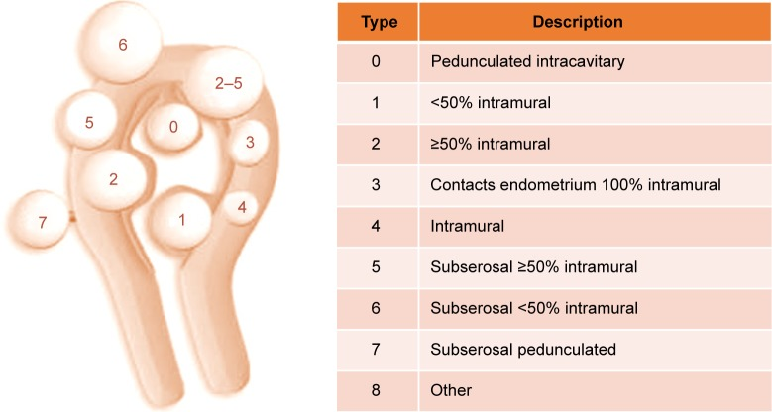
The International Federation of Gynecology and Obstetrics (FIGO) classification system for uterine fibroids

Slide 4
Risk Factors
Several factors may affect a woman’s risk for having uterine fibroids, including the following:
Age (older women are at higher risk than younger women) (peak incidence at 40 to 50).
African American race
Obesity
Family history of uterine fibroids
High blood pressure
Nulliparity
Early Menarche
Genetic variants
Vitamin D deficiency
Factors that may lower the risk of fibroids:
Pregnancy (the risk decreases with an increasing number of pregnancies)
Long-term use of oral or injectable contraceptives

Slide 5
Asymptomatic Fibroids
The majority of uterine leiomyomas are asymptomatic and will not require therapy. But they need follow-up.
Women with asymptomatic fibroids should be reassured that there is no evidence to substantiate major concern about malignancy and that hysterectomy is not indicated.

Slide 6
Symptomatic Fibroids
20% to 50% are clinically symptomatic, causing:
Heavy or prolonged menstrual bleeding
Iron deficiency anemia
Bulk effects:
1-Pelvic pressure or pain
2-Urinary tract or bowel issues (frequency, urgency, bowel dysfunction)
3-Venous compression
Reproductive issues (miscarriages, infertility)
Obstetric complications

Slide 7
Pelvic Pain
Causes of pelvic pain with fibroids:
Degeneration
Torsion
Impaction
possible associated adenomyosis and/or endometriosis

Slide 8
Fibroid Degeneration
Degeneration happens when fibroids outgrow their blood supply.
Degeneration is described as hyaline, myxomatous, calcific, cystic, fatty, red (most common during pregnancy), or necrotic.
Hyaline degeneration (63%) is the most common degenerative change in fibroid.

Slide 9
Fibroids & Pregnancy
Most patients with fibroids do not have any complications during pregnancy related to the fibroids.
One-third of fibroids may grow in the first trimester
Pain is the most common complication of fibroids in pregnancy, and is seen most often in women with fibroids > 5 cm during the second and third trimesters of pregnancy.
Pain due to red degeneration, torsion, or impaction

Slide 10
Fibroids & Pregnancy
Red Degeneration of Fibroids:
Red degeneration is a hemorrhagic infarction of the uterine leiomyoma, which is a well-known complication, especially during pregnancy.
Pain may be associated with a low-grade fever, uterine tenderness on palpation, elevated white blood cell count, or peritoneal signs.
Pain is usually managed conservatively by bed rest, hydration, and analgesics.

Slide 11
Fibroids & Pregnancy
There may be a slightly increased risk of obstetric complications:
Early pregnancy loss
Bleeding in early pregnancy
Preterm labor and birth
Fetal malpresentation (Breach, malpresentation)
Placental abruption
Labor dystocia
Cesarean delivery
Postpartum hemorrhage

Slide 12
Myomectomy during pregnancy or C/S
Most authorities agree that every effort should be made to avoid performing a myomectomy at the time of cesarean delivery due to the well-substantiated risk of severe hemorrhage requiring blood transfusion, uterine artery ligation, and/or hysterectomy.

Slide 13
Type of delivery after Myomectomy
According to ACOG guidelines (American College of Obstetricians and Gynecologists): Given the potential risk for uterine rupture, elective cesarean delivery is recommended in women with a history of full-thickness myometrial incisions, especially if the surgical report confirms entry into the endometrial cavity.
Vaginal delivery may be possible after myomectomy only if the surgery did not enter the full thickness of the uterine wall and the endometrial cavity was not opened.

Slide 14
Fibroid and malignancy
The probability of malignancy is extremely rare
Most recent reviews are consistent with older studies and estimate that in women undergoing surgery for fibroids approximately 1 in 400 (0.25%) is at risk of having a leiomyosarcoma.
Whether leiomyosarcomas develop from leiomyomas or arise independently is not known. The challenge lies in the fact that leiomyomas and leiomyosarcomas cannot reliably be distinguished clinically or by any imaging technique.
Rapid growth of a fibroid does not seem to be a predictor of leiomyosarcoma. However postmenopausal growth or onset of symptoms should carry a higher index of suspicion for malignancy.

Slide 15
DIAGNOSIS
History
Physical Examination
Laboratory testing
Imaging

Slide 16
History
Analysis of the chief complaint
Characteristics of vaginal blood loss.
Interference with daily activities, performance at work, sexual life and social & family relations.
Menstrual history
Intermenstrual bleeding and Postcoital bleeding
Anemia symptoms
Urinary and bowel symtoms
Associated pain
Family history of fibroid, gynecological malignancies.
Medical history
Drug history

Slide 17
Physical Examination
General : Vital Signs, Pallor
Thyroid Exam
Abdomen Exam: tenderness, masses (if the fibroid size >12 w it may be palpable)
Pelvic Exam:
1- Bimanual Exam: enlarged, mobile uterus with an irregular contour is consistent with fibroid uterus.
2- Speculum Exam:
A prolapsed submucosal fibroid may be visible at the external cervical os.
Other cervical pathologies may be detected
HVS & Pap Smear may be taken

Slide 18
Imaging
Ultrasonography (transabdominal, transvaginal, contrast sonohysterorography) is the most widely used modality because of its availability, ease of use, and cost-effectiveness.
Contrast infusion saline or gel sonography and 2D and 3D sonohysterography are very accurate diagnostic procedures to detect submucosal lesions, all with sensitivity and specificity of 98% to 100%.
MRI is the most accurate modality in assessing the adnexae and the uterus because it provides information on the size, location, number, and perfusion of leiomyomas as well as the presence of other uterine pathology including adenomyosis and/or adenomyoma.
Diagnostic Hysteroscopy

Slide 19
Management
Treatment of women with uterine leiomyomas must be individualized, based on:
Associated symptoms.
The size, number and location of fibroids.
Age and proximity to menopause
The needs and desires of the patient for preservation of fertility or the uterus, and the preferences of the patient.
General medical condition.
The availability of therapy, and the experience of the therapist.
Good quality of life and patient satisfaction must be our goals in the management of fibroids.

Slide 20
Treatment options
The first step in the management: Correct Anemia if present
Expectant management
Medical therapy
Non-excisional procedures: (eg, Endometrial ablation, Uterine Artery Embolization, Magnetic Resonance Guided Focused Ultrasound)
Surgery: (Myomectomy, Hysterectomy).

Slide 21
Expectant Management
Expectant management is for asymptomatic women, except in the case of a woman with moderate or severe hydronephrosis or a woman with a hysteroscopically-resectable submucous leiomyoma who is pursuing pregnancy.
Most women experience shrinkage of fibroids and relief of symptoms at menopause; therefore, depending on the severity of their symptoms, women who are approaching menopause may choose to wait for the onset of menopause before deciding on treatment.

Slide 22
Medical Therapy
The aim: to decrease blood loss
NSAID
Tranexamic acid
Oral Contraceptives
Progestins
Danazol
The levonorgestrel Intrauterine System (LNG IUD) (MIRENA)
Gonadotropin-Releasing hormone analogues (GnRh analogues)
Selective Progesterone Receptor Modulators

Slide 23
Non-excisional procedures
1) Endometrial ablation
2) Uterine Artery Embolization
3) Magnetic Resonance Guided Focused Ultrasound (MRgFUS)
The fact that ovarian reserve and healthy myometrium may be compromised by Uterine Artery Embolization still discourages its use in women who desire future pregnancy.
MRgFUS do not appear to affect fertility, and is also a good method for UFs with difficult surgical access

Slide 24
Surgical Procedures
1) Myomectomy is an option for women who have not completed childbearing or otherwise wish to retain their uterus.
It can be accomplished using:
Open abdominal approach
Laparoscopic approach
Hysteroscopic approach ( For intracavitary fibroids)
2) Hysterectomy
This option is a radical and definitive treatment, particularly for women who do not wish to conceive and/or women aged above 40–50 year.

