Slide 1
Intrapartum Fetal Monitoring (CTG)
Dr Amal Barakat
5th & 6th Year Medical Students
Jordan University
March/ 2025

Slide 2
OBJECTIVES
Discuss the modality used to monitor fetal wellbeing in labor
How to read a normal CTG?
List causes of abnormal CTG in labor

Slide 3
Intrapartum fetal surveillance
Fetal Heart Rate Monitoring (FHR)
  - Intermittent auscultation
  - Continuous electronic fetal heart monitoring (EFM)
Fetal Scalp blood pH estimation
Intrapartum fetal stimulation tests
  - Fetal scalp stimulation tests
  - Fetal acoustic stimulation test (FAST)
Newer approaches
  - Fetal ECG
  - Scalp blood lactate estimation
  - Continuous biochemical monitoring
    (Pulse oximetry)

Slide 4
Fetal heart rate (FHR) monitoring
Fetal heart rate (FHR) monitoring can be done by:
  Structured Intermittent Auscultation
  Continuous Electronic Fetal Monitoring (EFM)
  1) External
  2) Internal

Slide 5
Structured Intermittent Auscultation
The FHR should be assessed at least every 30 minutes in the first stage of labor and every 15 minutes in the second stage .
It ensures frequent contact between healthcare professionals and the laboring woman.
If abnormal, continuous EFM is recommended.

Slide 6
Continuous Electronic Fetal Monitoring (EFM)
Continuous electronic fetal monitoring is the continuous monitoring of fluctuations of the fetal heart rate (FHR) in relation to maternal contractions and is considered standard practice during active labor.

Slide 7
External Electronic Continuous Fetal Monitoring
An ultrasound transducer transmits the FHR in beats per minute.
Non-invasive.
Does not require cervical dilatation or rupture of membranes.
Needs readjustment with maternal or fetal movements.
Difficult to obtain a clear tracing in obese women or those with polyhydramnios.

Slide 8
External Electronic Continuous Fetal Monitoring

Slide 9
Internal Electronic Continuous Fetal Monitoring
Performed with a spiral electrode inserted through vagina and cervix and attached to the fetal scalp.
Indicated when the external tracing is inadequate for accurate interpretation such as: obese women or those with polyhydramnios.
Contraindications include: placenta previa, face presentation, unknown presentation, HIV seropositivity, or active genital herpes.
Internal uterine activity monitoring is done via an intrauterine pressure catheter (IUPC).

Slide 10
External Vs Internal
External monitors measure only contraction frequency, but an intrauterine pressure catheter can also determine the strength of contractions.
Placement of an intrauterine pressure catheter (IUPC) or fetal scalp electrode requires cervical dilation and amniotomy, which can increase the risk of intrauterine infection, fetal injury, and the transmission of herpes simplex virus and hepatitis B or C.

Slide 11
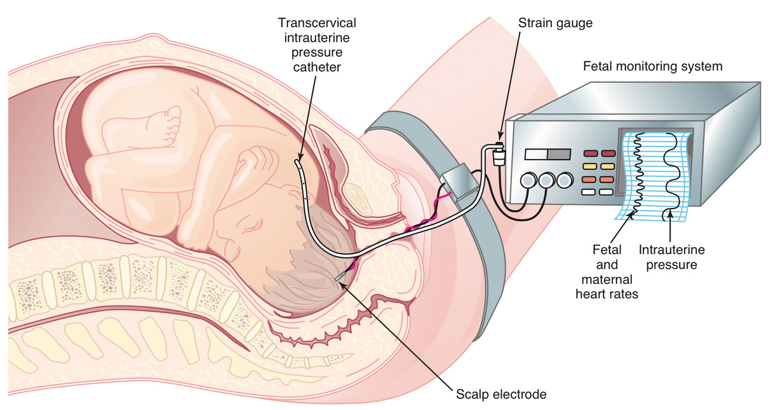
Internal Electronic Continuous Fetal Monitoring

Slide 12
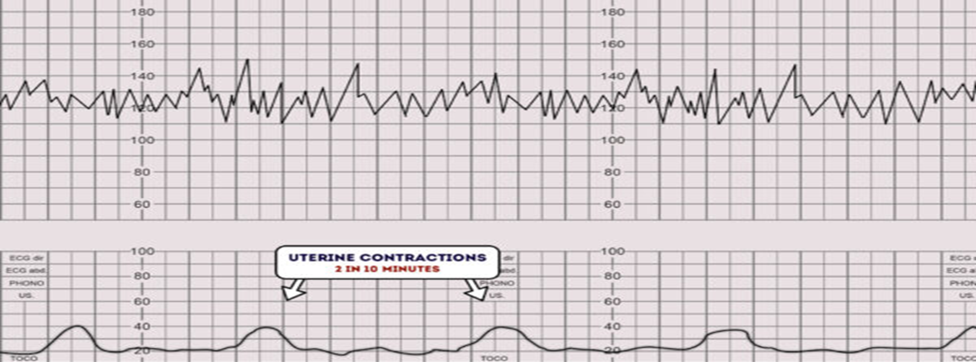
The cardiotocograph has two components:
Fetal Heart
Contractions

Slide 13
How to read a CTG?
Name of the patient & Date
Define the risk
Contractions (frequency & duration)
Baseline FHR (normal 110 bpm – 160 bpm)
FHR variability (beat to beat variation)
Acceleration (present or absent)
Deceleration (Early, Late & Variable)
Assessment & plan of management
The overall impression can be described as either reassuring, suspicious or abnormal.

Slide 14
Assessment of uterine contractions
The lowest intrauterine pressure between contractions is called resting tone.
Normal resting tone is 5-10 mmHg, but during labor it may rise to 10-15 mmHg.
Pressure during contractions rises to ~25-100 mmHg (varies with stage).
A resting pressure above 20 mmHg causes decreased uterine perfusion.

Slide 15
Montevideo Units
Montevideo units are a method of measuring uterine performance during labor.
It is calculated by internally (not externally) measuring peak uterine pressure amplitude (in mmHg), subtracting the resting tone of the contraction, and adding up the numbers in a 10-minute period.
Generally, above 200 MVUs is considered necessary for adequate labor during the active phase.

Slide 16
Contractions
The number of contractions in a 10-minute period is recorded.
Hyperstimulation : More than 5 contractions in 10 minutes.
Hyperstimulation can result in hypoxia, acidosis & abnormal fetal heart rate

Slide 17
Change in Uterine Blood Flow with Contractions
Normal human labor is characterized by regular uterine contractions, which cause repeated intermittent reductions of blood flow to the intervillous spaces resulting in repeated transient interruptions of fetal oxygenation. Contractions may also compress the umbilical cord and fetal head.
Most fetuses tolerate this process well because of placental reserve and effective compensatory mechanisms, but some do not because of preexisting uteroplacental insufficiency and/or intrapartum factors.

Slide 18
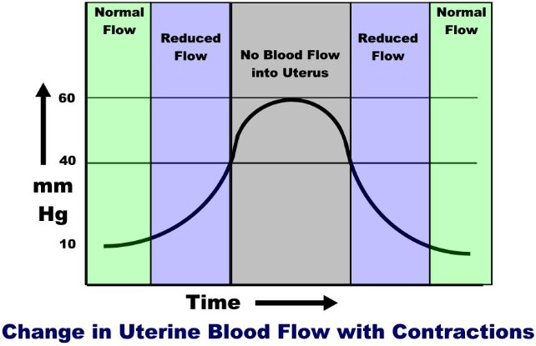
Change in Uterine Blood Flow with Contractions

Slide 19
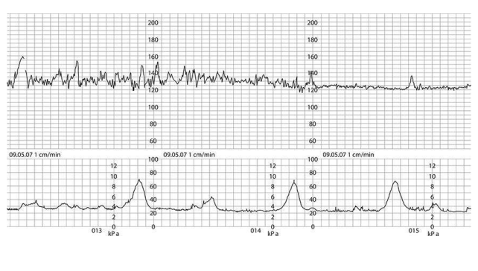
A normal cardiotocograph (CTG), showing a baseline fetal heart rate of approximately 120 bpm, frequent accelerations, baseline variability of 10– 15 bpm and no decelerations.
The uterus is contracting approximately once every 5 minutes

Slide 20
Baseline Rate
Normal fetal heart rate: Between 110-160 bpm

Slide 21
Tachycardia: A baseline value above 160 bpm lasting more than 10 minutes.
Causes:
Maternal pyrexia (infection, chorioamnionitis)
Fetal hypoxia.
Medications (beta-agonist (Ritodrine (Yutopar)Terbutaline (Bricanyl) (drugs used for tocolysis) (Atropine) (Sympathomimetic drugs) (Parasympatholytic drugs)
Fetal arrhythmias (SVT ) associated with congenital anomalies (VSD)
Fetal or maternal anemia.
Fetal hypoxia
Hyperthyroidism
Prematurity

Slide 22
Bradycardia: A baseline value below 110 bpm lasting more than 10 minutes
Values between 100 and 110 bpm may occur in normal fetuses, especially in postdate pregnancies.
Causes:
Maternal hypothermia, Hypotension, Hypoglycemia
Administration of beta-blockers
Fetal arrhythmias such as atrioventricular block
(SSA/Ro positive pregnancies (systemic lupus erythematosus (SLE) and Sjögren's syndrome (SS)) associated with heart block)
Fetal metabolic acidosis

Slide 23
Variability
It refers to the fluctuations in the baseline FHR
Variability occurs as a result of the interaction between the nervous system, chemoreceptors, baroreceptors and cardiac responsiveness.
Normal variability indicates an intact neurological system in the fetus
Normal variability is between 5-25 bpm.
Absent variability = Amplitude range undetectable
Minimal = < 5 BPM
Moderate = 6 to 25 BPM
Marked = > 25 BPM

Slide 24
Variability
Persistently minimal or absent FHR variability appears to be the most significant intrapartum sign of fetal compromise.
On the other hand, the presence of good FHR variability may not always be predictive of a good outcome.

Slide 25
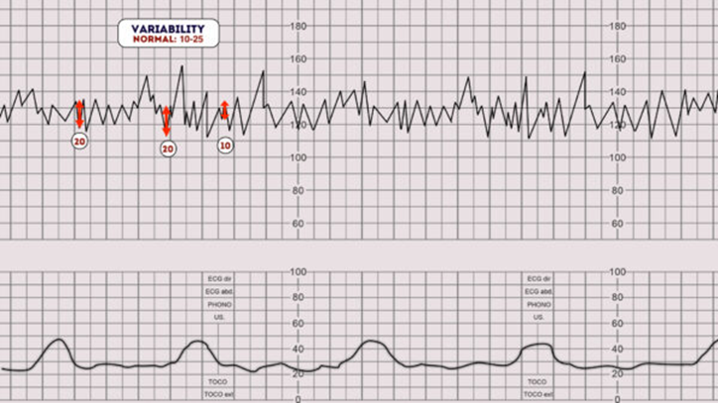
Normal Variability

Slide 26
Variability
Variability can be categorized as:
Reassuring: 5 – 25 bpm
Non-reassuring:
less than 5 bpm for between 30-50 minutes
more than 25 bpm for 15-25 minutes
Abnormal:
less than 5 bpm for more than 50 minutes
more than 25 bpm for more than 25 minutes
sinusoidal

Slide 27
Reduced Variability

Slide 28
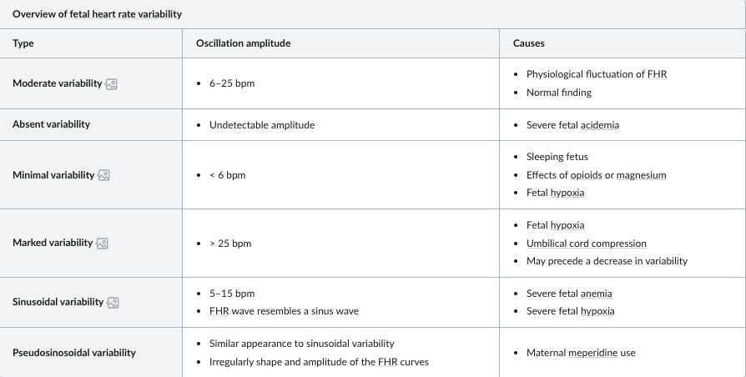
Variability

Slide 29
Causes of Reduced Variability
Reduced variability can be caused by any of the following:
Fetal sleeping: this should last no longer than 40 minutes (this is the most common cause)
Fetal Hypoxia & acidosis, more likely if late decelerations are also present
Fetal tachycardia
Drugs: (opiates, benzodiazepines, methyldopa and magnesium sulphate, betamethasone)
Prematurity: variability is reduced at earlier gestation (<28 weeks)
Congenital heart abnormalities

Slide 30
Sinusoidal Pattern
Sinusoidal pattern is a regular, smooth, undulating pattern resembling a sinus wave, with amplitude 5-15 bpm at frequency 3-5 cycles/min, lasting for >30 min and coinciding with absent accelerations.
A sinusoidal CTG pattern has the following characteristics:
A smooth, regular, wave-like pattern
Frequency of around 2-5 cycles a minute
Stable baseline rate around 120-160 bpm
No beat-to-beat variability

Slide 31
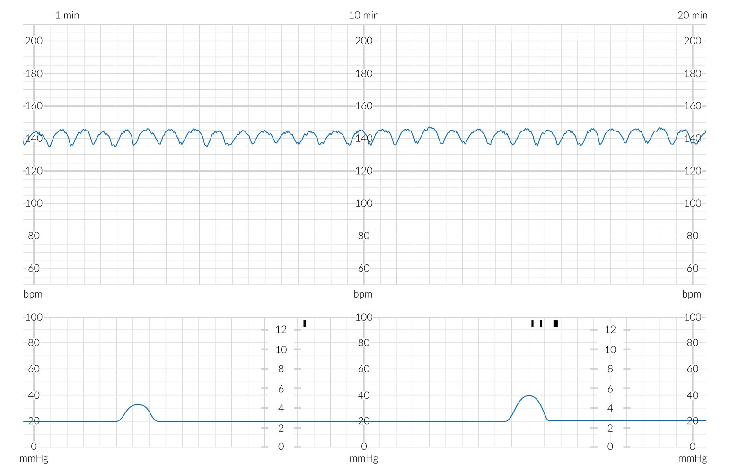
Sinusoidal Pattern:
A regular, smooth, undulating signal, resembling a sine wave

Slide 32
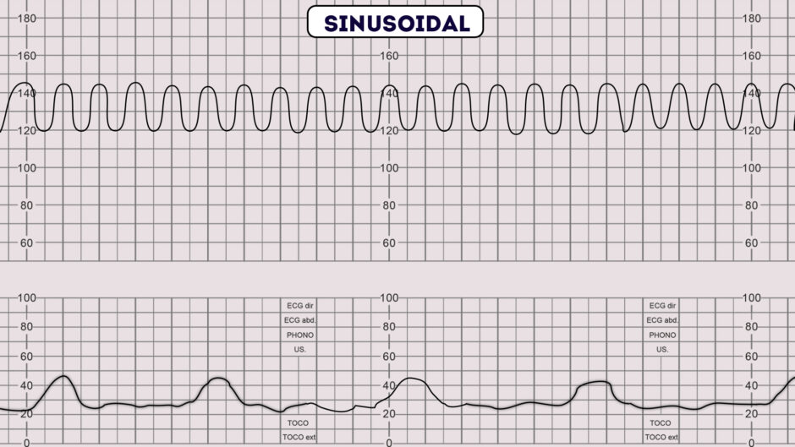
Sinusoidal Pattern

Slide 33
Causes of Sinusoidal Pattern
Sinusoidal pattern is very concerning as it is associated with high rates of fetal morbidity and mortality
It occurs in association with:
Severe fetal hypoxia
Severe fetal anemia
Fetal-maternal hemorrhage
Ruptured vasa previa

Slide 34
Accelerations
Accelerations are an abrupt increase in the baseline fetal heart rate of greater than 15 bpm for greater than 15 seconds.
The presence of accelerations is reassuring. It indicates a neurologically responsive fetus without hypoxia/acidosis.
The absence of accelerations with an otherwise normal CTG is of uncertain significance.
Adequate accelerations are defined as:
<32 weeks' : >10 BPMabove baseline for >10 seconds
>32 weeks' : >15 BPM above baseline for > 15 seconds

Slide 35
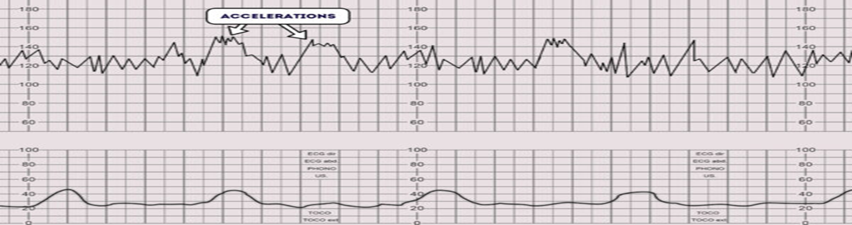
Accelerations

Slide 36
Remember
Uterine hyper-contractility is the most frequent cause of a pathological CTG
Baseline and variability are the most important features on a CTG – they are indicative of hypoxia.
Remember a fetus will protect its heart muscle as a priority…….the other organs and the brain will suffer the hypoxia first.
Interpret the CTG in the full clinical context and understanding of the fetal reserve.

Slide 37
Decelerations
Decelerations are an abrupt decrease in the baseline fetal heart rate of greater than 15 bpm for greater than 15 seconds.
Early ( Type 1)
Late (Type 2)
Variable (Type 3)

Slide 38
Early decelerations
Cause: Head Compression
Gradual decrease in the FHR and return to baseline associated with uterine contraction.
Early decelerations are shallow, short-lasting, have normal variability, and are coincident with uterine contraction.
The onset, nadir, and recovery of the decelerations coincide with the beginning, peak, and ending of the contraction.
This type of deceleration is not pathological and do not indicate fetal hypoxia/acidosis.

Slide 39
Early decelerations

Slide 40
Late decelerations
Cause: Uteroplacental Insufficiency
Late decelerations are U-shaped with reduced variability, start more than 20 s after the onset of uterine contraction with a gradual onset with >30 s to nadir, have a nadir after the acme (the highest point) of contraction, and return to baseline gradually with >30 s from nadir to baseline
Late decelerations begin at the peak of the uterine contraction and recover after the contraction ends.
Insufficiency is caused by uterine tachysystole (hyperstimulation), maternal hypotension, epidural or spinal anesthesia, IUGR, intraamniotic infection, or placental abruption.
Severe, repetitive late decelerations usually indicate fetal metabolic acidosis.

Slide 41
Late decelerations

Slide 42
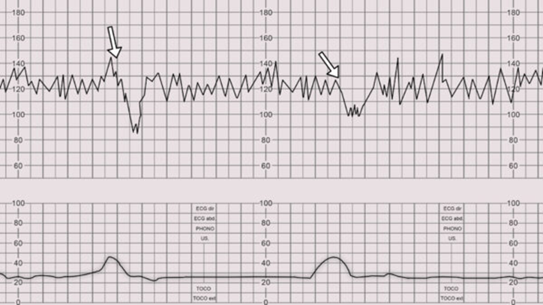
Late decelerations

Slide 43
Management of Late decelerations
Maternal left lateral position to improve uterine blood flow
Correct maternal hypotension with IV fluids
Administer O2 by mask
Stop oxytocin infusion
Consider tocolytic drugs to slow down or stop contractions that are provoking the decelerations
Vaginal examination
If persistent perform fetal scalp PH
If persistent consider immediate delivery

Slide 44
Variable decelerations
Cause: Cord compression
Variable decelerations are V-shaped. Variable in onset, duration and depth. They may occur with contractions or between contractions.
Typically, they have an abrupt onset and rapid recovery (in contrast to other types of decelerations which gradually slow and gradually recover).

Slide 45
Variable decelerations

Slide 46
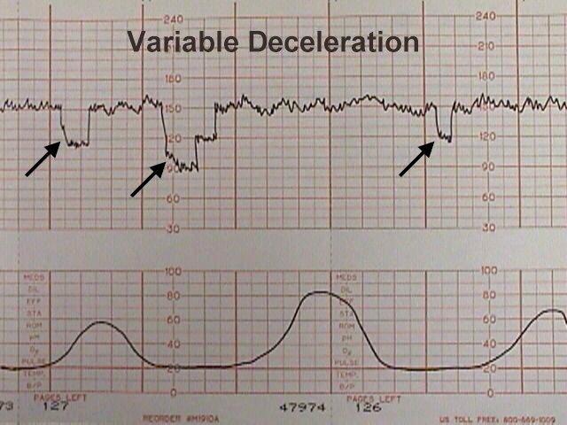
Variable Decelerations

Slide 47
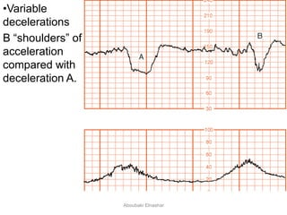
The accelerations before and after a variable deceleration are known as the shoulders.
Pressure on the cord initially occludes the umbilical vein, which results in an acceleration (the shoulder of the deceleration) and indicates a healthy response.
Their presence indicates the fetus is not yet hypoxic and is adapting to the reduced blood flow.

Slide 48
Management of variable decelerations
Changing maternal position to improve uterine blood flow
IV hydration to increase maternal blood volume, presumably leading to increased uterine blood flow
Administering oxygen to the mother to try to get some additional oxygen through to the fetus. (The least useful).
Decreasing or discontinuing oxytocin infusion to slow down or stop contractions that are provoking the decelerations.
We may consider Amnioinfusion to improve oligohydramnios
We may consider Tocolytic drugs to slow down or stop contractions that are provoking the decelerations.
Digital elevation of the fetal head out of the maternal pelvis to ease pressure on the umbilical cord

Slide 49
Management of variable decelerations
Occasional mild or moderate variable decelerations are common and not considered threatening.
Severe variable decelerations dip below 60 BPM for at least 60 seconds ("60 x 60").
If persistent and not correctable by simple means, they can be threatening to fetal well-being.
Like persistent, non-remediable late decelerations, fetuses demonstrating persistent, non-remediable severe variable decelerations should be delivered promptly.

Slide 50
Prolonged decelerations
Usually lasting more than 3 minutes.
If associated with reduced variability, they indicate acute fetal hypoxia/acidosis and require emergent intervention.

Slide 51
Causes of prolonged decelerations
Severe bradycardia: FHR less than 80 beats per minute, lasting longer than 3 minutes is an ominous finding and may be associated with fetal acidosis.
Could be transient due to:
Supine hypotension
Paracervical block
Epidural and spinal anesthesia
Other possible causes:
Prolonged cord compression
Cord prolapse
Tetanic uterine contractions (Hyper stimulation of the uterus with oxytocin or prostaglandin)
Maternal seizures
Rapid fetal descent may cause strong vagal response
Vigorous vaginal examination may cause strong vagal response
If associated with vaginal bleeding we have to think of: Major abruptio placenta, rupture uterus and vasa previa.

Slide 52
Prolonged decelerations

Slide 53
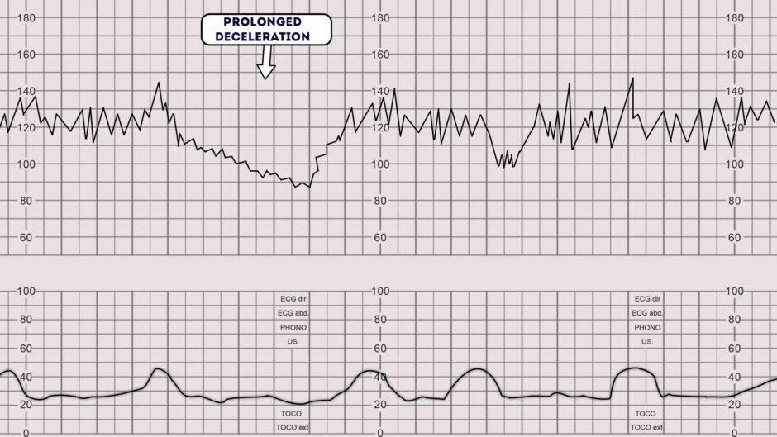
Prolonged Decelerations

Slide 54
Prolonged decelerations
There is a “rule of 3's” for fetal bradycardia when they are prolonged:
3 minutes – call for help.
6 minutes – move to theatre
9 minutes – prepare for delivery

Slide 55
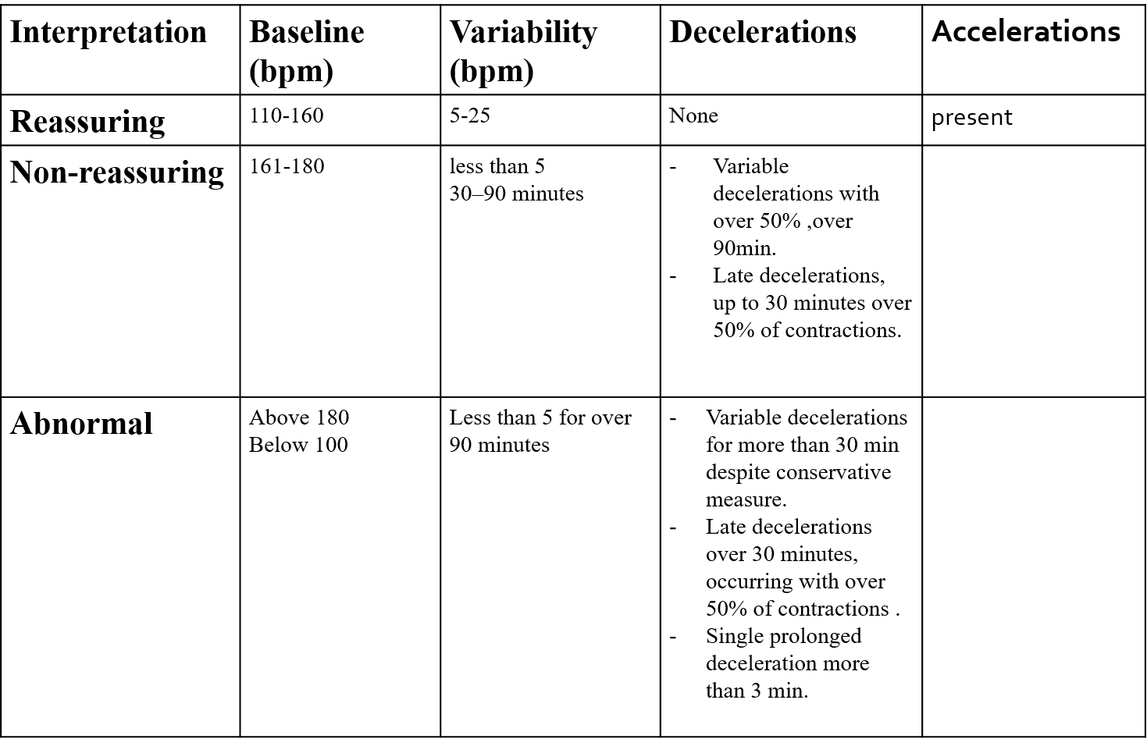
Interpretation of FH tracings

Slide 56
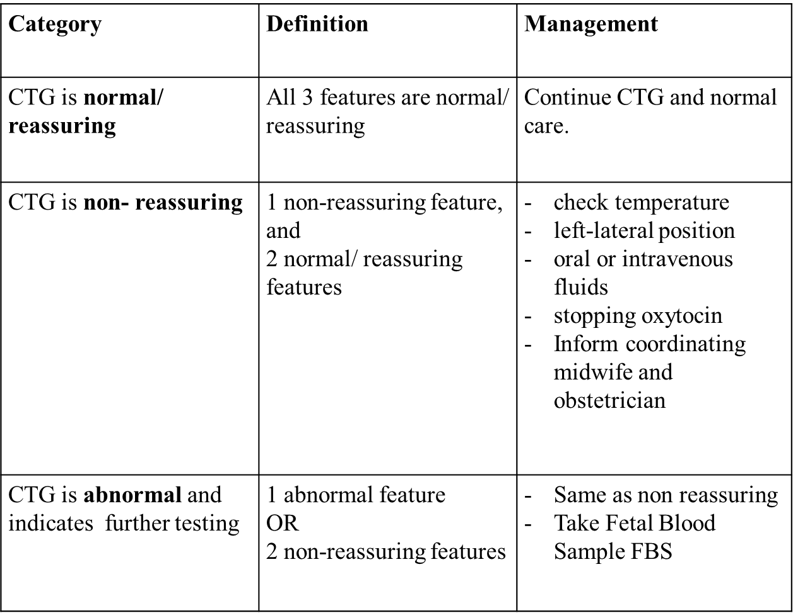
Interpretation of FH tracings

Slide 57
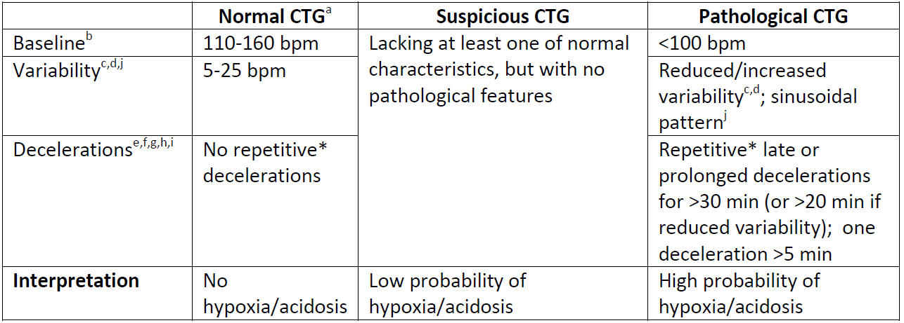
The FIGO 2015 intrapartum cardiotocography (CTG) classification system

Slide 58
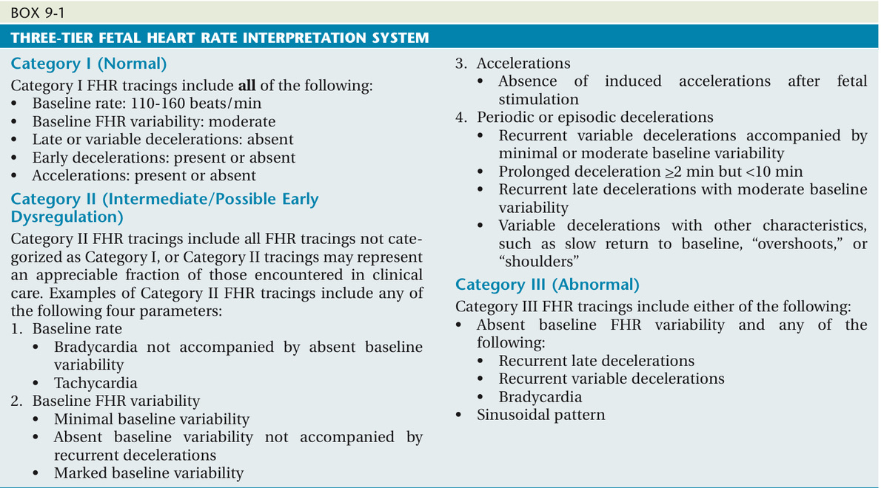
Category 1: Strongly predictive of normal fetal acid-base status at the time of observation.
Requires no specific management.

Slide 59
Category II FHR (Intermediate)
The fetal heart rate tracing shows ANY of the following:
Tachycardia, bradycardia without absent variability, minimal variability, absent variability without recurrent decelerations, marked variability, absence of accelerations after stimulation, recurrent variable decelerations with minimal or moderate variability, prolonged deceleration > 2minute but less than 10 minutes, recurrent late decelerations with moderate variability, variable decelerations with other characteristics such as slow return to baseline, and "overshoot".
Not predictive of abnormal fetal acid-base status, but requires continued surveillance and reevaluation.

Slide 60
Category II FHR (Intermediate)
Not predictive of abnormal fetal acid-base status, so management depends on clinical circumstances.
Search for the underlying cause (ex: maternal hypotension) and correct it.
Some interventions:
  Change the mother’s position to the left lateral recumbent.
  Reduce the infusion rate of oxytocin
  Increase intravenous fluids.

Slide 61
Category 3: Predictive of abnormal fetal acid-base status.
In addition to measures in category II treatment, may consider:
Fetal scalp blood sampling
Ultrasound doppler velocimetry
Delivery

Slide 62
Secondary Tests of Fetal Wellbeing
Fetal Scalp Sampling
Scalp stimulation
Acoustic stimulation
Fetal pulse oximetry
Fetal Electrocardiogram Analysis

Slide 63
Fetal Blood Sampling (Fetal Scalp PH)
FBS may be used in cases of abnormal CTG.
A vaginal examination needs to be performed prior to the procedure to assess the nature and position of the presenting part.
Contraindications : maternal infection, women seropositive to hepatitis B, C, or to HIV, suspected fetal blood disorders, uncertainty about the presenting part, preterm fetus.
CTG + FBS results in a reduction in cesarean deliveries when compared with CTG alone

Slide 64
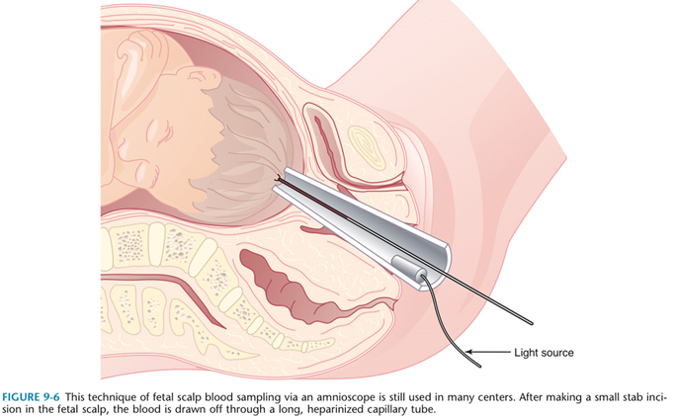
Fetal Scalp PH

Slide 65
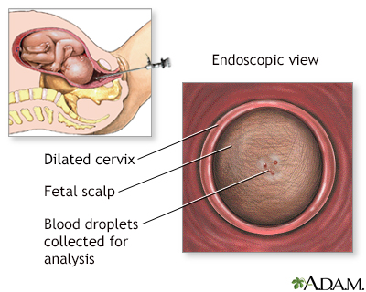
Risks of FBS:
Continued bleeding from the puncture site (more likely if the fetus has a pH imbalance)
Infection
Bruising of the baby's scalp

Slide 66
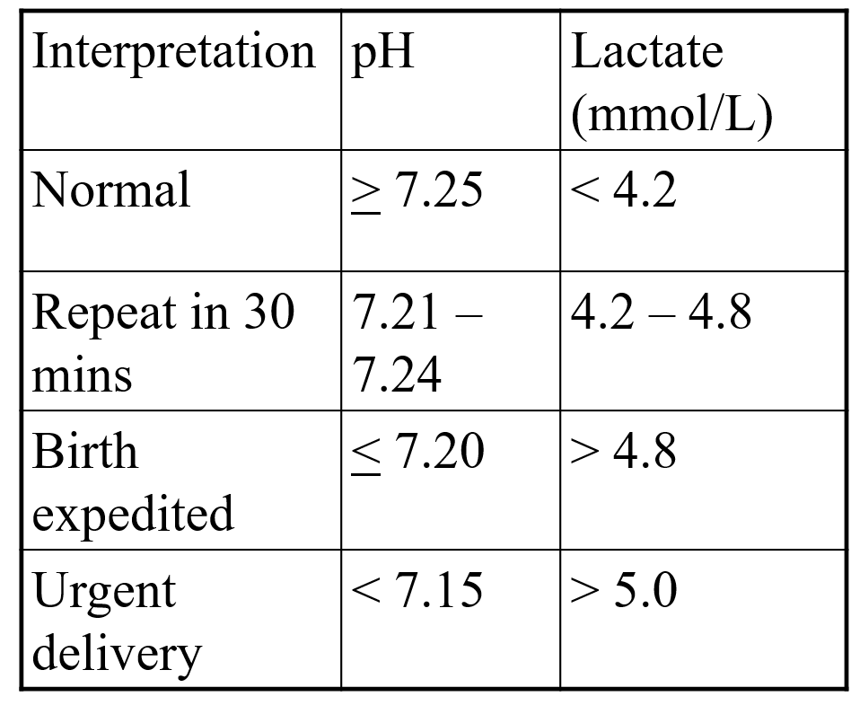
Fetal Blood Sampling (Fetal Scalp PH)

Slide 67
Dr Amal Barakat
Thank you
The End of Intrapartum Fetal Monitoring

