Slide 1
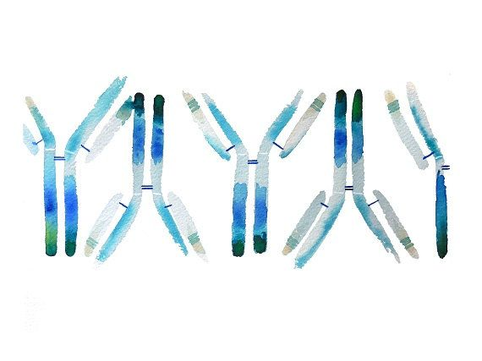
Medical Immunology
Anas Abu-Humaidan M.D. Ph.D.
Lecture 2

Slide 2
Immunology introduction
The immune system includes the role of physical, cellular, and chemical systems that are in place and that respond to all aspects of foreignness.
The immune system targets any “foreign” object, so the first step is to recognize what is self and non- self.
The second step is to restore homeostasis by eliminating the foreign object.
The third step is to remember the invading pathogen to respond better the next time it is encountered .
The immune system is not only active when danger arises, but is constantly sensing danger and is important for normal physiology and homeostasis similar to the cardiovascular and renal systems.

Slide 3
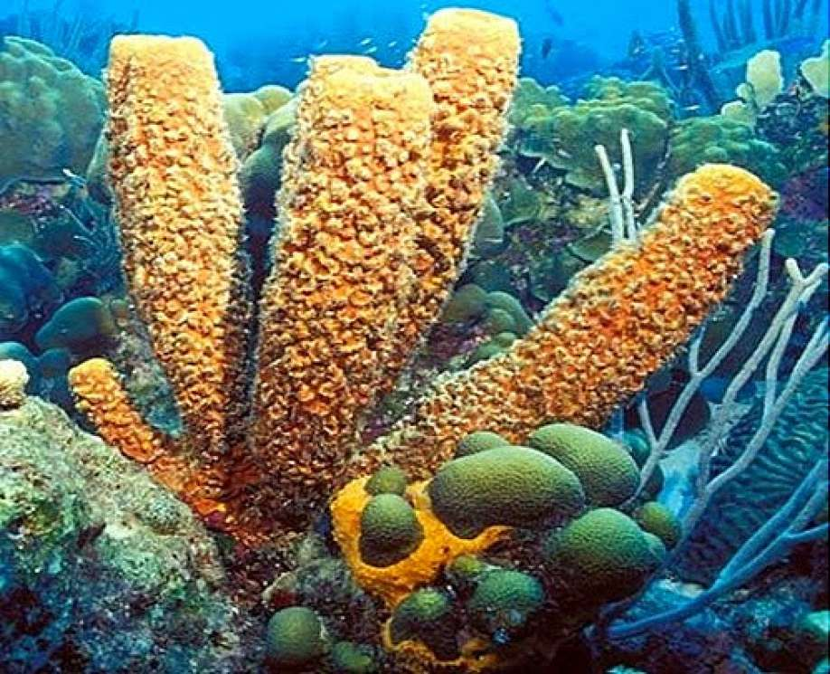
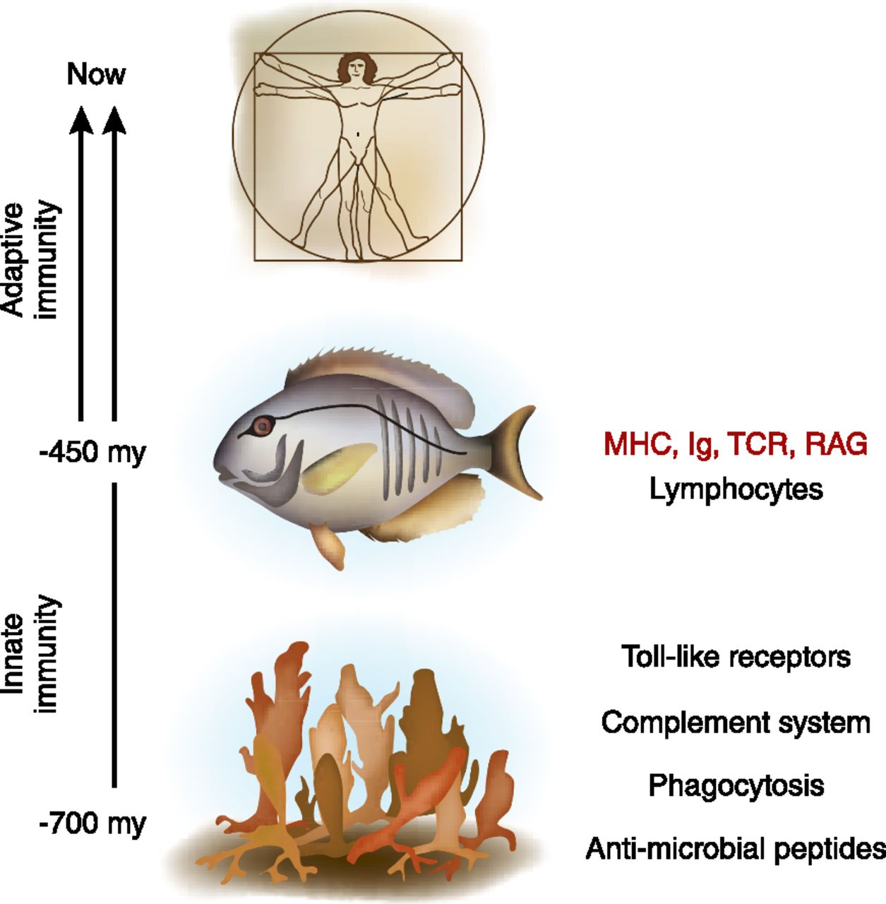
Immunology introduction/ co-evolution
Mechanisms for discriminating "self" from "non-self" evolved to accomplish the task of fighting pathogens, launching a long history of host-pathogen co-evolution.
Virtually all organisms have at least one form of defence that helps repel disease-causing organisms.
Pathogens evolve new strategies to over come immune mechanisms, and so the host defence becomes more complex to defend against invading pathogens.
Jawed vertebrates have developed higher complexity of defence reflected in the adaptive immune response.
Transplantation of parts of sponge to other sponges is met by an immune response

Slide 4
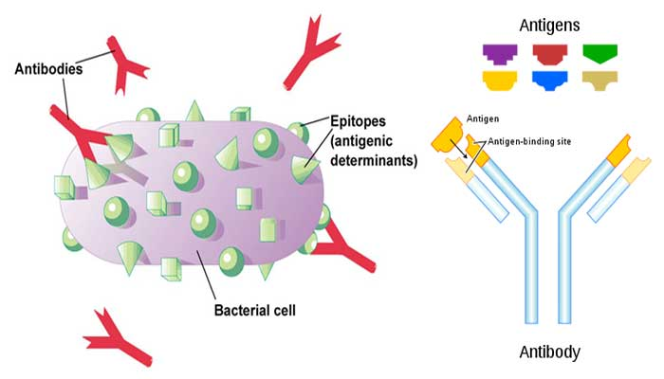
Immunology introduction / What is forgein?
Antigens are any substance that stimulates the immune system to produce antibodies. Antigens can be bacteria, viruses, or fungi that cause infection and disease.
Antigens may also originate from within the body ("self-antigen"), but should not be attacked by the immune system in normal situations.

Slide 5
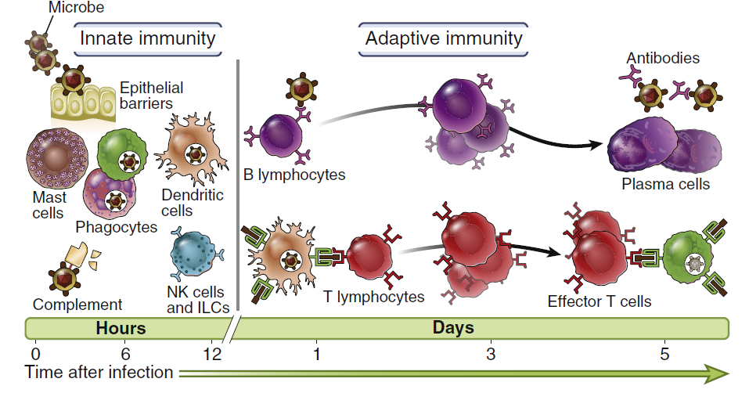
Immunology introduction / INNATE AND ADAPTIVE IMMUNITY
Host defenses are grouped under innate immunity, which provides immediate protection against microbial invasion, and adaptive immunity, which develops more slowly and provides more specialized defense against infections

Slide 6
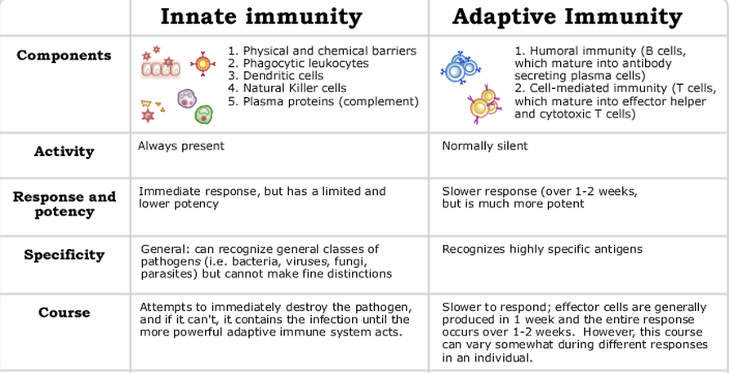
Immunology introduction / INNATE AND ADAPTIVE IMMUNITY

Slide 7
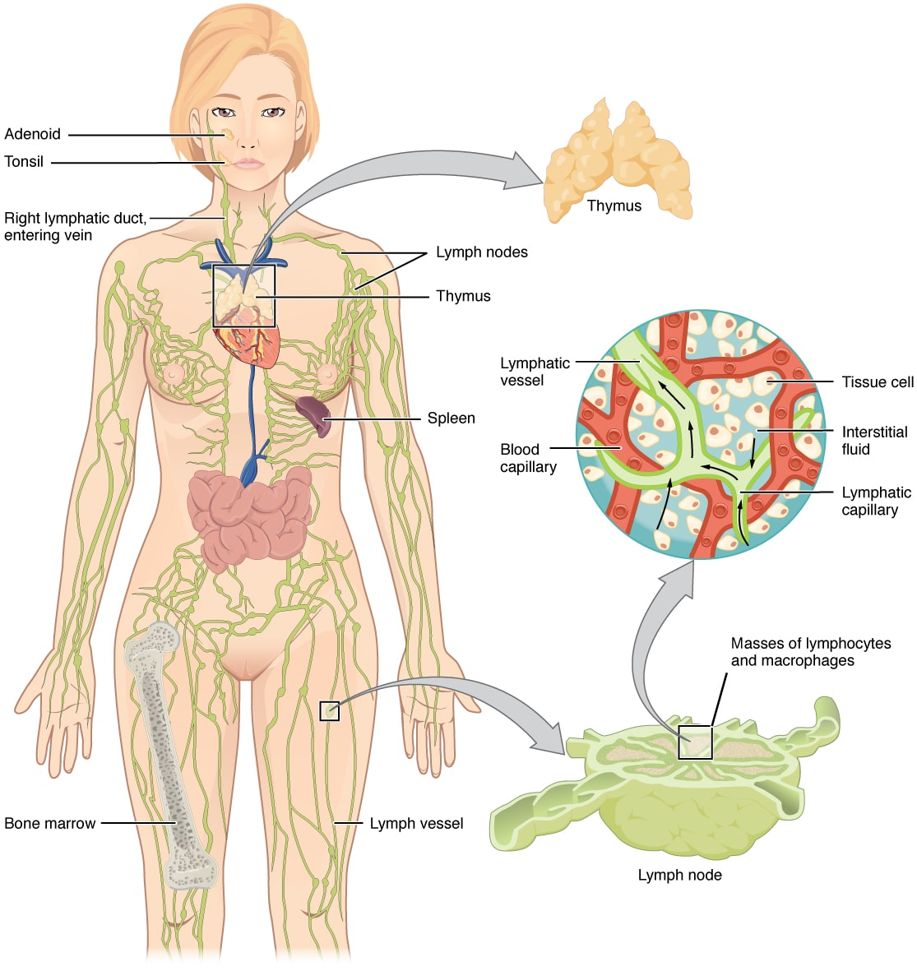
Immunology introduction / Location of the immune system
The immune system duty is to survey the whole body so it should be present everywhere. But there are sites where immune cells collect to fulfil their function (e.g. lymph nodes).
For example, in the small intestine there is lymphatic tissue that surveys intestinal pathogens called Peyer's patches.
The bone marrow is an important place for generation of immune and non-immune blood cells.

Slide 8
Immunology introduction / Conclusions
Immunology is a relatively recent science with applications that extend to other medical sciences, thus it is important for medical students.
The immune system in an ancient defence mechanism composed of tissues, cells and molecules that interact with each other with great complexity.
Parts of the immune system are continuously active, and help in maintaining homeostasis.
Specialized immune cells are mainly in the bone marrow and then circulate the blood or aggregate in lymph nodes.
The immune system arms can be divided in general into innate and adaptive.

Slide 9
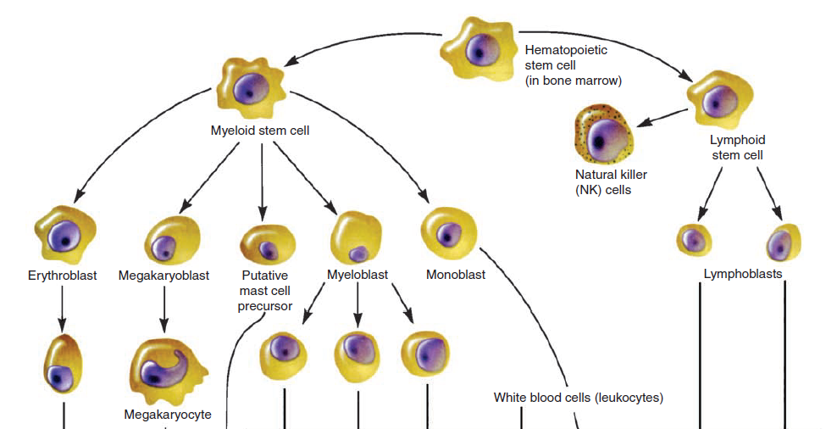
Cells of the immune system
The cells of the innate and adaptive immune system are normally present as circulating cells in the blood and lymph, as anatomically defined collections in lymphoid organs, and as scattered cells in virtually all tissues.

Slide 10
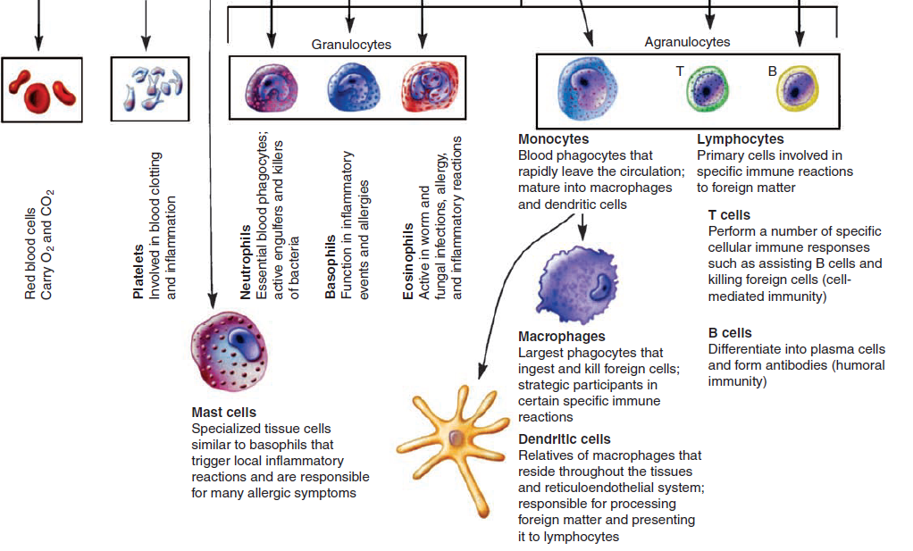
Cells of the immune system
Phagocytes
Mast Cells, Basophils, Eosinophils
Antigen-Presenting Cells
Lymphocytes

Slide 11
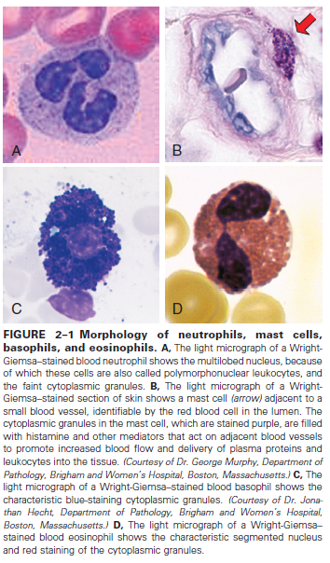
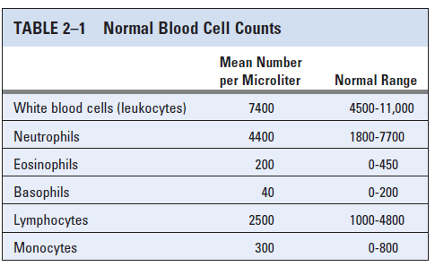
Cells of the immune system
Although most of these cells are found in the blood, their responses to microbes are usually localized to tissues.

Slide 12
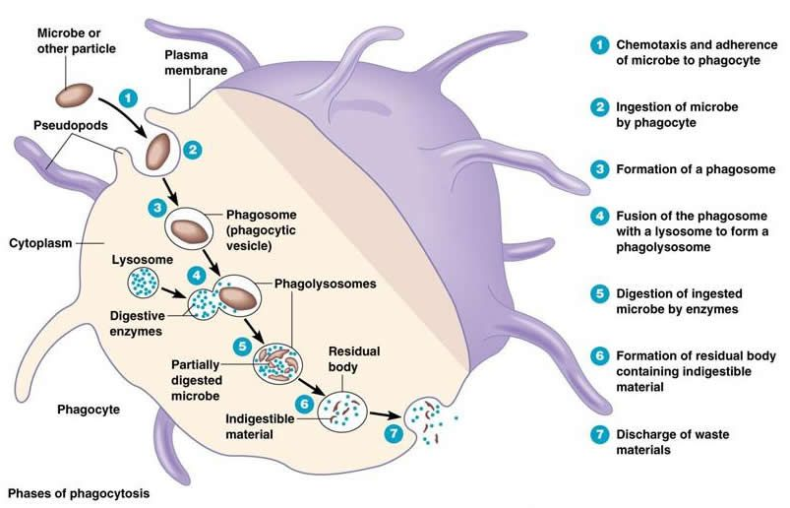
Cells of the immune system / Phagocytes
Phagocytes, including neutrophils and macrophages, are cells whose primary function is to identify, ingest, and destroy microbes.
Phagocytes also communicate with other cells in ways that promote or regulate immune responses.

Slide 13
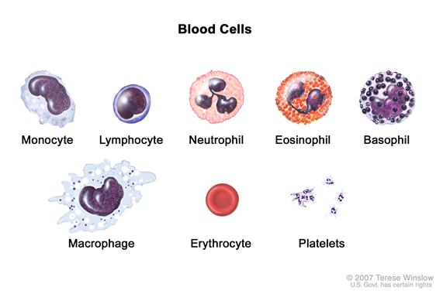
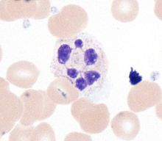
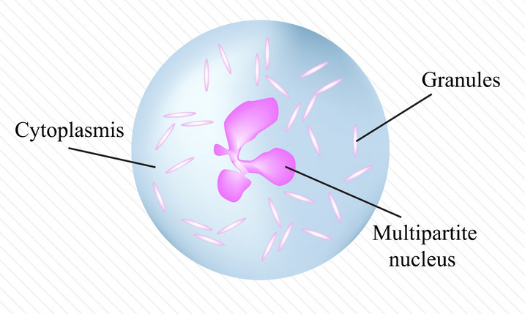
Cells of the immune system / Phagocytes/ Neutrophils
Neutrophils, also called polymorphonuclear leukocytes, are the most abundant population of circulating white blood cells and mediate the earliest phases of inflammatory reactions.
The nucleus of a neutrophil is segmented into 3-5 connected lobules
Short lifespan, they circulate for about 6 hours, Production of neutrophils is stimulated by granulocyte colony-stimulating factor (G-CSF). An adult human produces more than 1 × 10¹¹ neutrophils per day

Slide 14
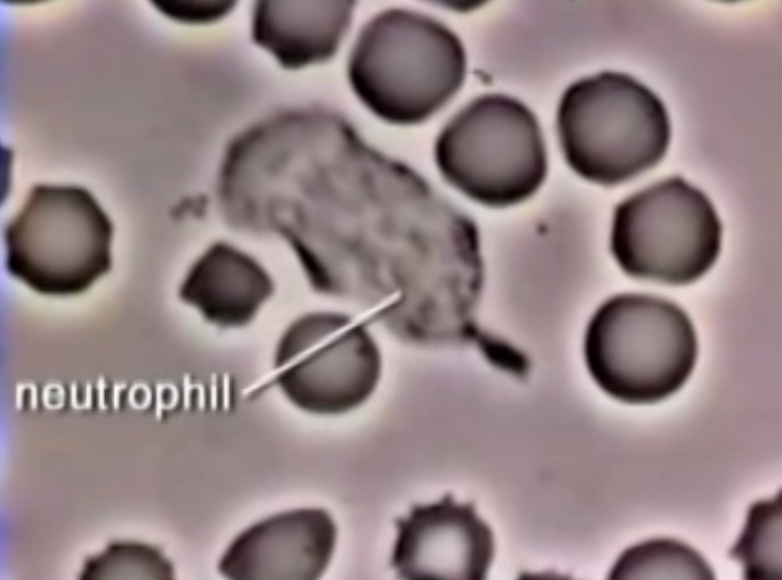
Cells of the immune system / Phagocytes/ Neutrophils
The cytoplasm contains granules of two types. The majority, called specific granules, are filled with enzymes such as lysozyme, collagenase, and elastase. The remainder are azurophilic granules, which are lysosomes containing enzymes and other microbicidal substances.
Neutrophils may migrate to sites of infection within a few hours after the entry of microbes.
After entering tissues, neutrophils function for a few hours and then die.

Slide 15
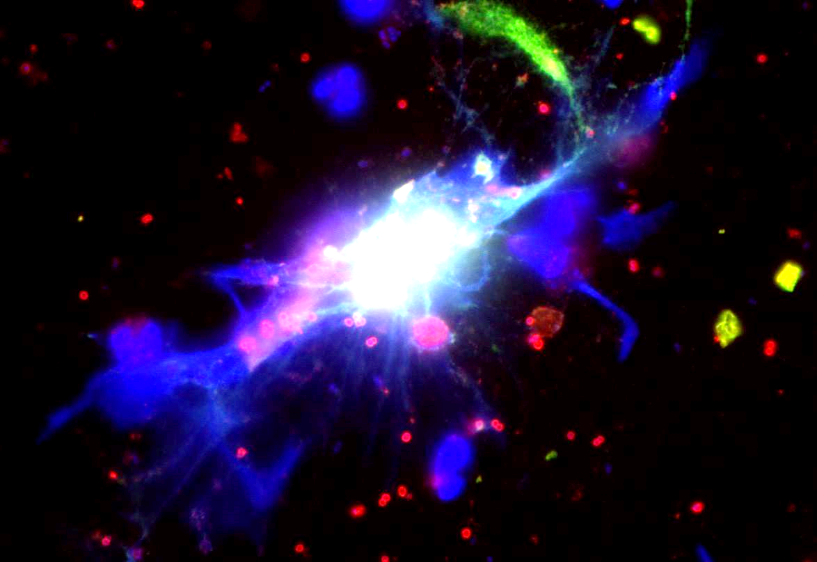
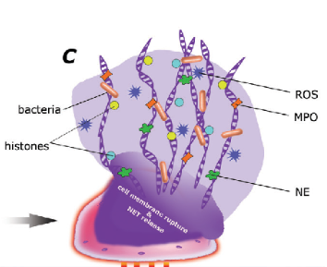
Cells of the immune system / Phagocytes/ Neutrophils
Neutrophil extracellular traps (NETs) are networks of extracellular fibers, primarily composed of DNA from neutrophils, which bind pathogens.

Slide 16
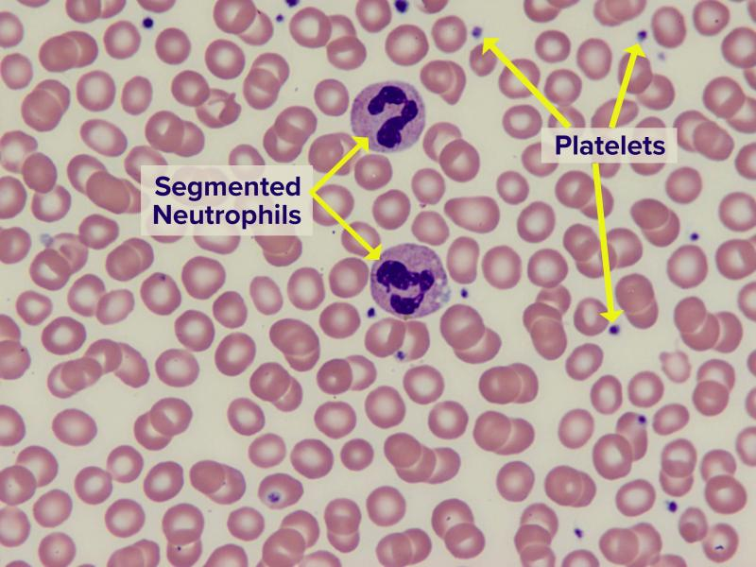
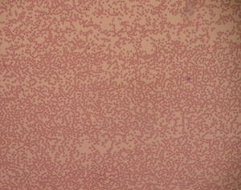
Blood film with a striking absence of neutrophils, leaving only red blood cells and platelets
Neutropenia is an abnormally low concentration of neutrophils in the blood. Neutropenia has many causes and can be congenital and acquired (e.g. cancer treatment, autoimmune diseases).

Slide 17
Febrile Neutropenia
JP is a 34-year-old Caucasian male who is admitted to inpatient oncology service for induction chemotherapy for a recent diagnosis of acute myeloid leukemia (AML). His induction chemotherapy regimen consists of 7 + 3 induction chemotherapy with cytarabine and daunorubicin. He was placed on neutropenic precautions, started on appropriate antimicrobial prophylaxis, and a port was placed for chemotherapy administration. Ten days after the completion of his induction chemotherapy (day 17), he spiked a fever of 38.8°C (101.8°F) and complained of chills and nausea.

Slide 18
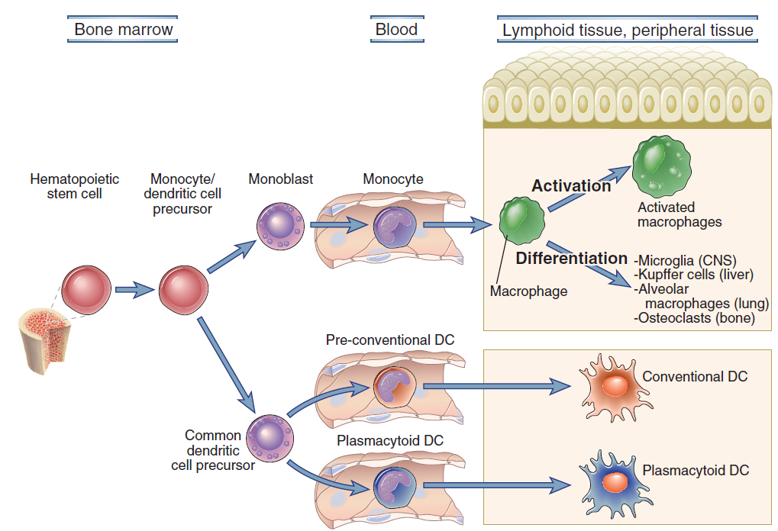
Cells of the immune system / Phagocytes/ Mononuclear Phagocytes
The cells of the mononuclear phagocyte system originate from a common precursor in the bone marrow, circulate in the blood as monocytes, and mature and become activated in various tissues.
Once monocytes enter tissues, mature and become macrophages. Macrophages in different tissues have been given special names to designate specific locations.

Slide 19
Cells of the immune system / Phagocytes/ Macrophages
In addition to ingesting microbes, macrophages also ingest dead host cells as part of the cleaning up process after infection or sterile tissue injury.
Activated macrophages secrete proteins, called cytokines, that bind to signalling receptors on other cells and thereby instruct those cells to respond in ways that contribute to host defence.
Macrophages serve as APCs that display antigens to and activate T lymphocytes.
Another important function of macrophages is to promote repair of damaged tissues by stimulating new blood vessel growth (angiogenesis) and synthesis of collagen-rich extracellular matrix (fibrosis).

Slide 20
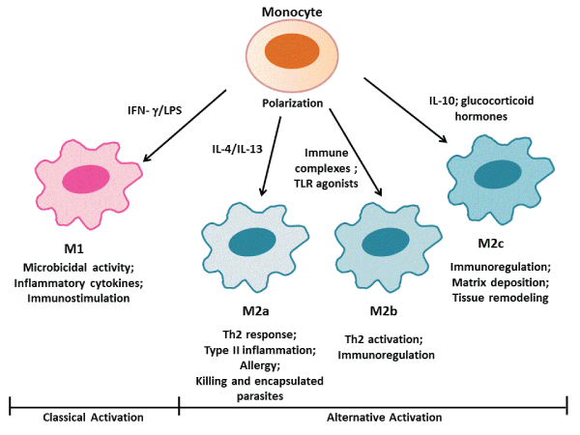
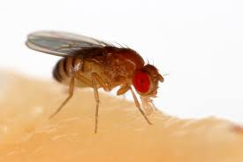
Cells of the immune system / Phagocytes/ Macrophages
Macrophage-like cells are phylogenetically the oldest mediators of innate immunity. Drosophila responds to infection by surrounding microbes with “hemocytes,”
which are similar to macrophages, and these cells phagocytose the microbes and wall off the infection.
Macrophages can acquire distinct functional capabilities, depending on the types of activating stimuli

Slide 21
Cells of the immune system / Mast Cells, Basophils, Eosinophils
All three cell types share the common feature of having cytoplasmic granules filled with various inflammatory and antimicrobial mediators.
Another common feature of these cells is their involvement in immune responses that protect against helminths and immune responses that cause allergic diseases

Slide 22
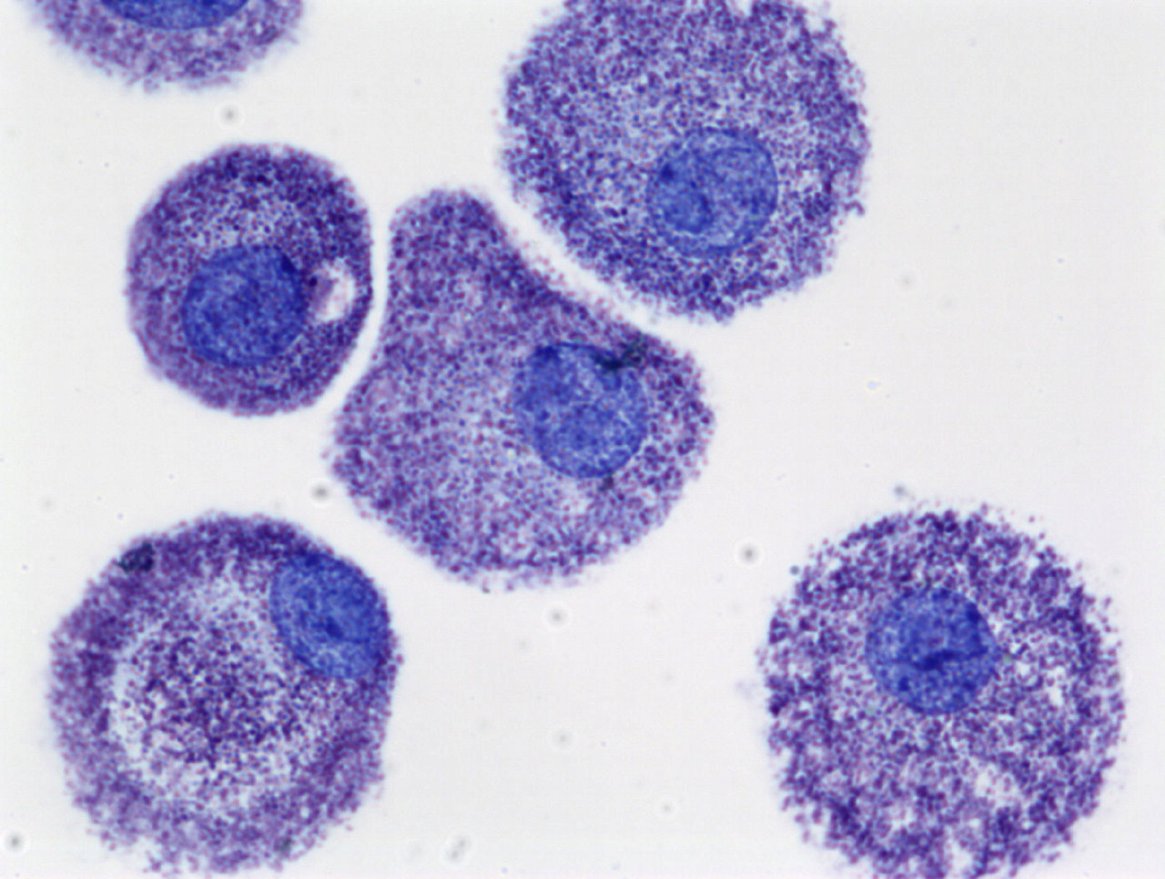
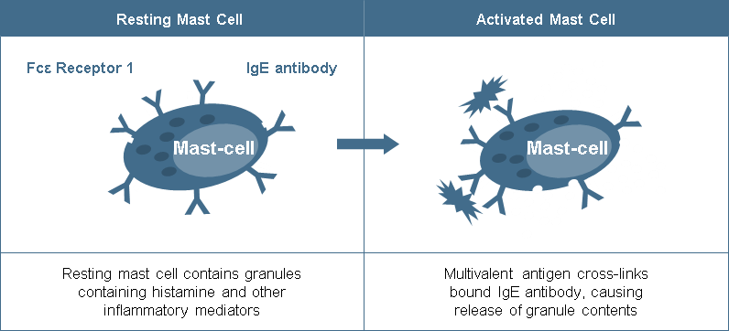
Cells of the immune system / Mast Cells
Mast cells are bone marrow–derived cells that are present in the skin and mucosal epithelium and contain abundant cytoplasmic granules filled with cytokines histamine, and other mediators.
Mature mast cells are not found in the circulation but are constitutively present in healthy tissues, usually adjacent to small blood vessels and nerves.
Mast cells express plasma membrane receptors for IgE and IgG antibodies and are usually coated with these antibodies

Slide 23
Cells of the immune system / Basophils
Basophils are blood granulocytes with many structural and functional similarities to mast cells.
Like mast cells, basophils express IgG and IgE receptors, bind IgE, and can be triggered by antigen binding to the IgE.
Basophils constitute less than 1% of blood leukocytes, normally not present in tissues and their importance is uncertain.
When they participate in allergic reactions or responses to parasites, basophils release histamine and many other biologically active molecules that can contribute to inflammation.

Slide 24
Cells of the immune system / Eosinophils
Eosinophils are blood granulocytes that express cytoplasmic granules containing enzymes that are harmful to the cell walls of parasites but can also damage host tissues.
Several lines of evidence suggest that deficiency of eosinophils is not associated with any characteristic abnormality.

Slide 25
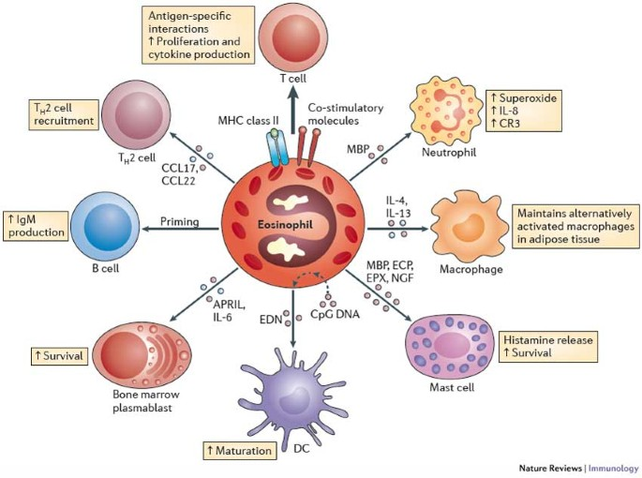
Eosinophils: changing perspectives in health and disease
https://www.nature.com/articles/nri3341

Slide 26
Further reading:
Cellular and Molecular Immunology. 7th Edition..
Chapter 2. Cells and tissues of the immune system

